Slide 1
What’s next? How we use feedback to decide what to build
David Simner

Slide 2
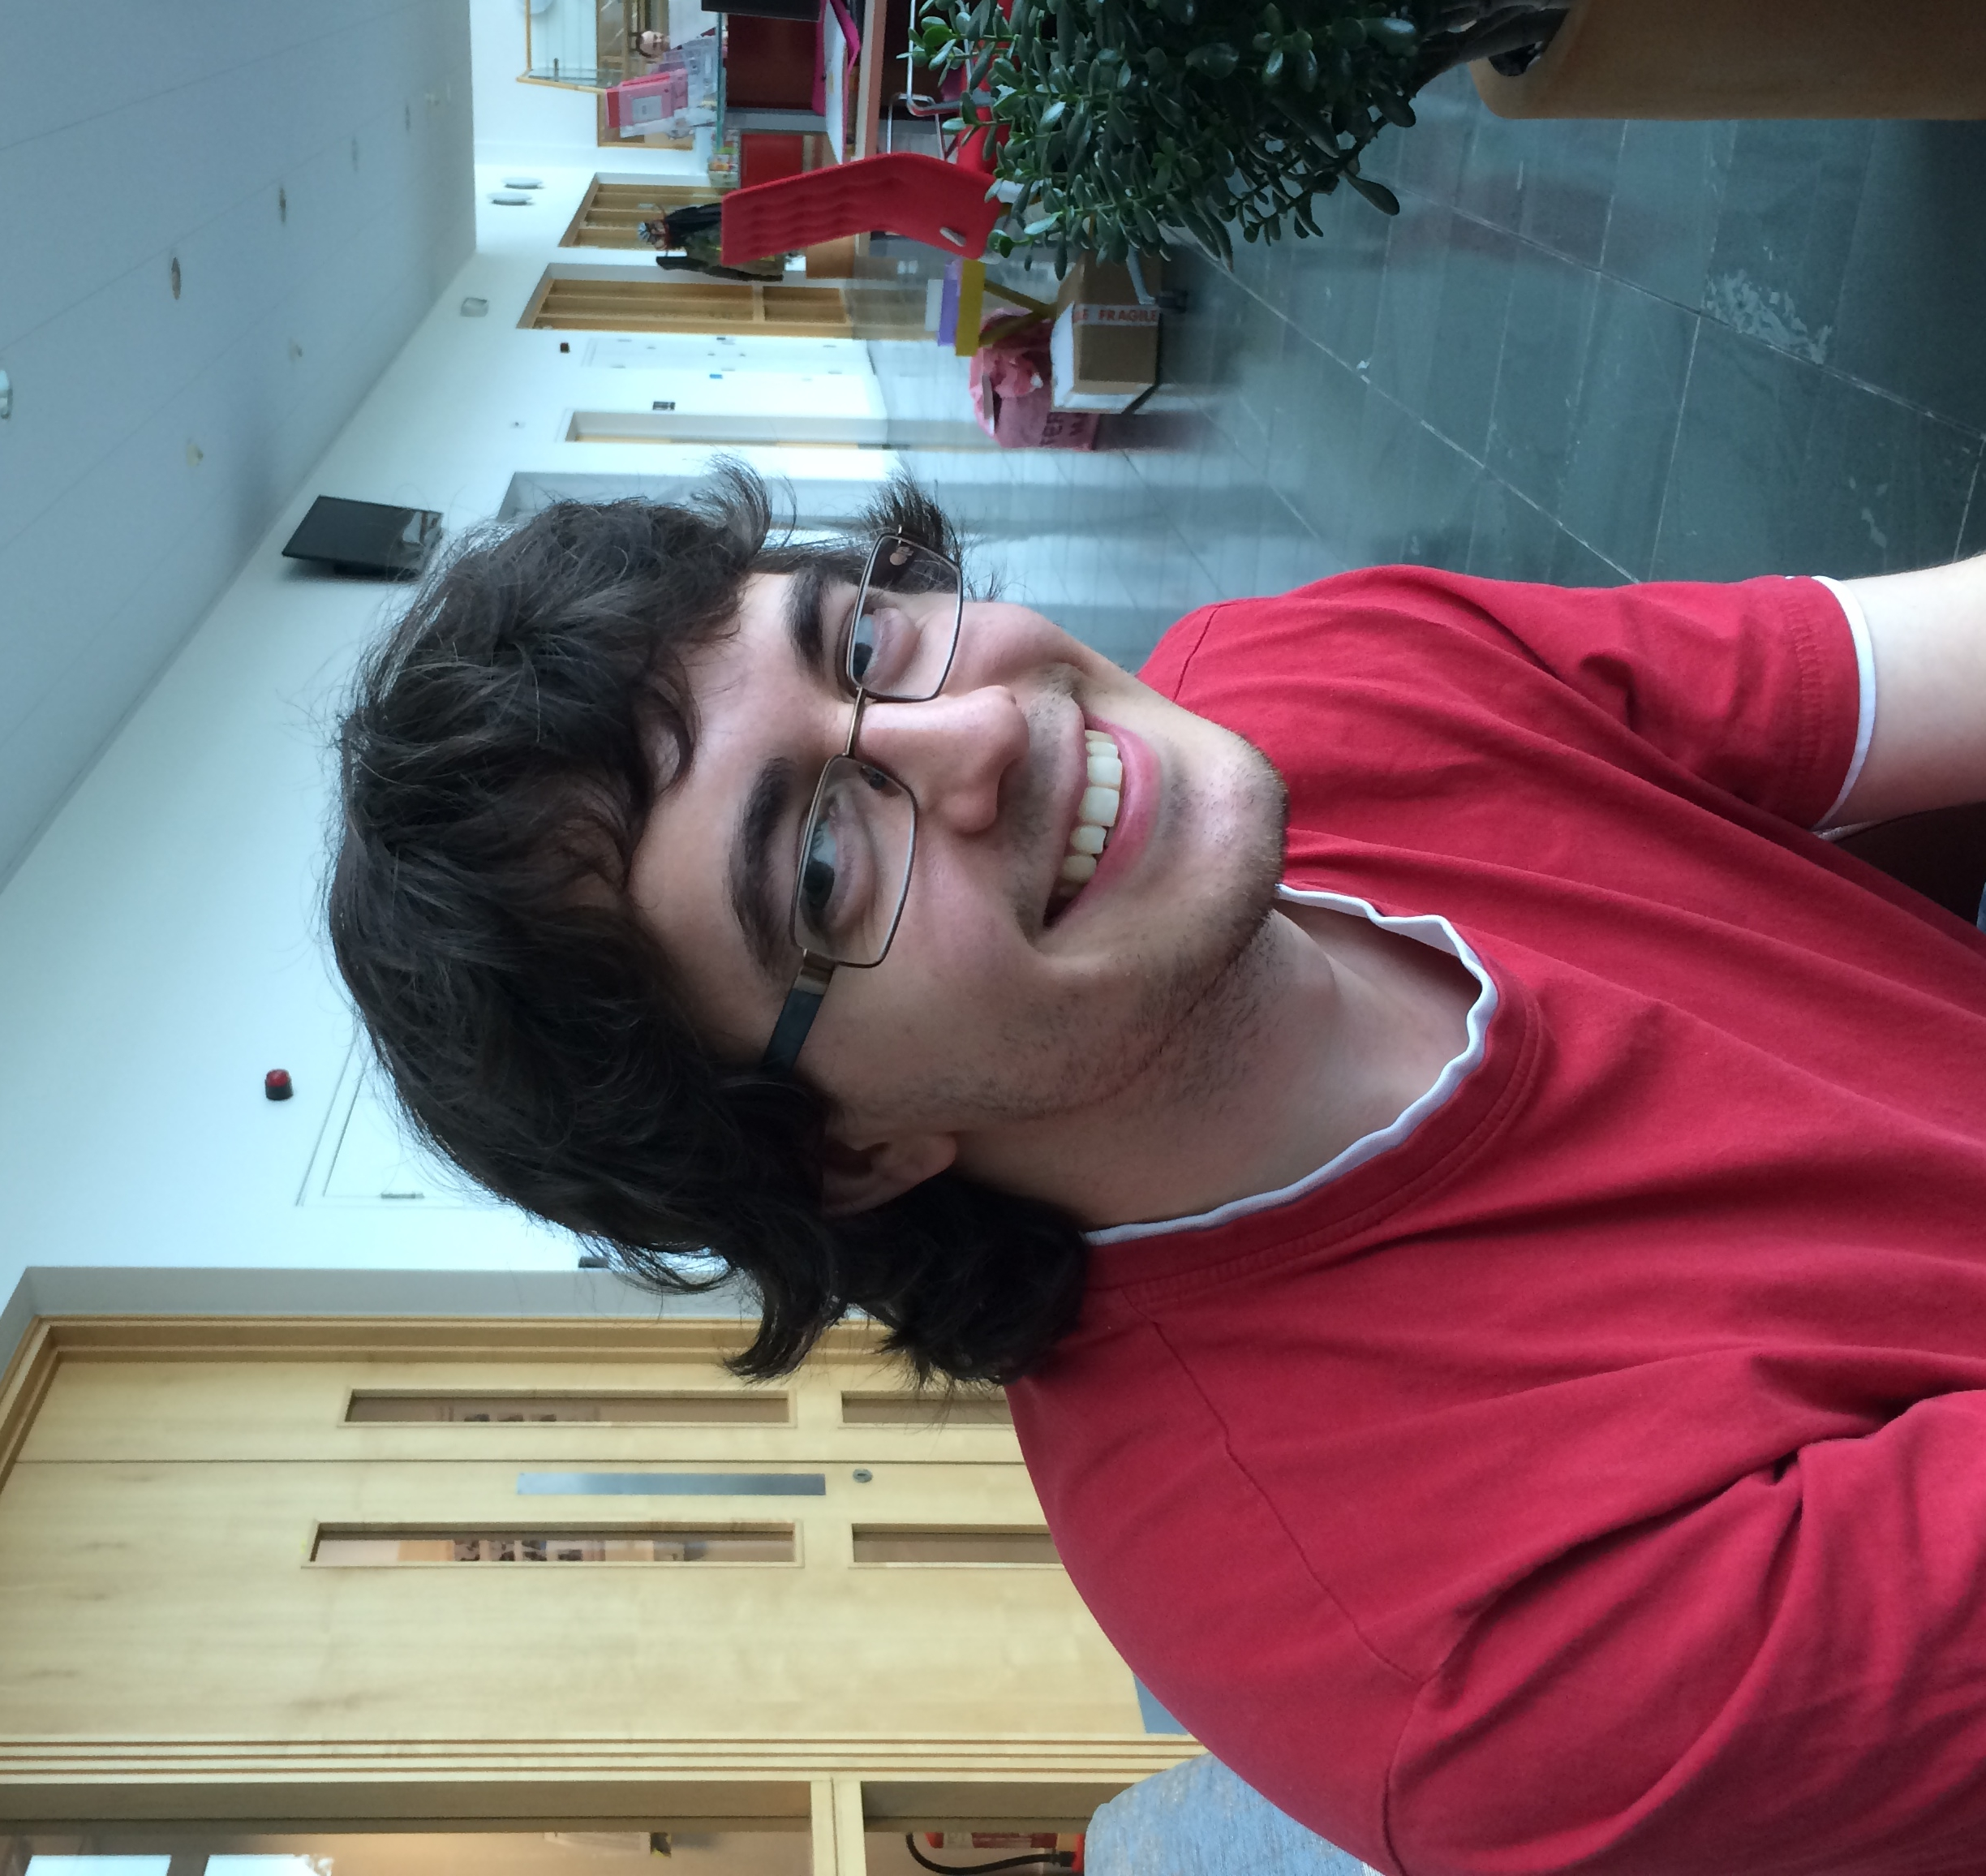
www.davidsimner.me.uk david.simner@red-gate.com
David Simner

Slide 3
What’s next? How we use feedback to decide what to build
A very brief look at why this is important
A whistle-stop tour of our prototype, alpha, and beta stages
An in-depth look at how our UI evolved and why
How we managed scope
Notes:
experience report from the most recent project I worked on

Slide 4

Users
Us
Notes:
This is what we’re trying to avoid…
This talk is about bridging the gap.
Throughout the talk, I’m going to give you lots of tips and tricks to help you do that.

Slide 5

Notes:
So why do we collect feedback from users in the first place?
The answer is that it’s a very important part of achieving the holy grail: product/market fit.
On this slide we have a market, and one of the people in that market, the dude in orange with his hand up, has asked to participate in our beta.
The hope is that by listening to the feedback from the dude in orange, we can build a better product, not just for them, but for everyone else in the market that they’re representative of.
And with that better product, we hope to make more money, and that’s good, because I like getting paid ;)
There is the difficultly of extrapolating from an early adopter to everyone though…

Slide 6
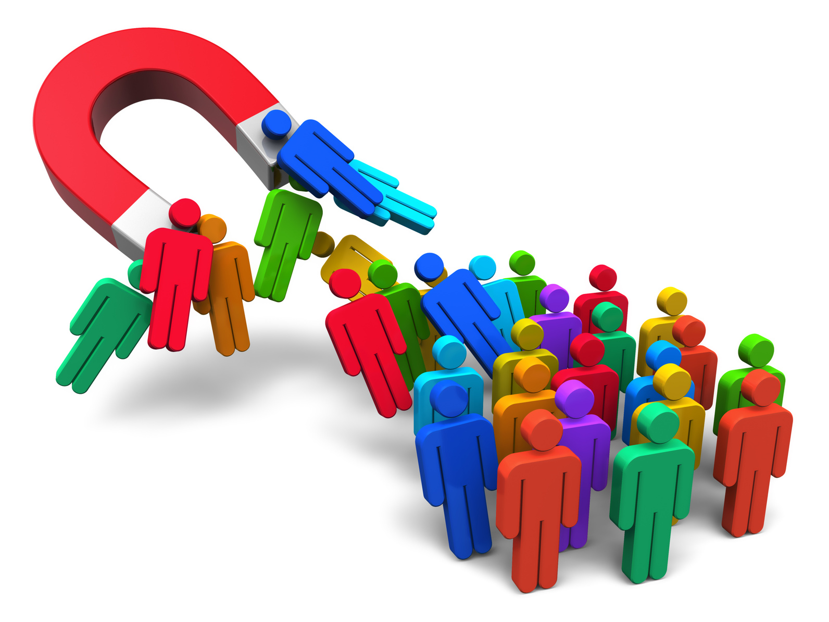
Notes:
Today’s talk is about feedback: how to collect feedback, how to use that feedback, etc…
It’s NOT about how to get users in the first place.
But that is a necessary pre-requisite – you obviously need to find people who’ll give you the feedback – I just won’t be going into any marketing aspects in this talk.

Slide 7
15,447
Notes:
We had some awesome marketing people, and over the course of the project I’m going to be talking about today, they got 15,447 people to download it and give us their email address.
This was awesome, because it meant we had a lot of people using the product, but, also, because we had their email address, it also meant that we had a lot of people to talk to.
So, to cut a long story short, you need an awesome marketing person.

Slide 8

Notes:
Right, let’s go!
This is how our project started – a nice green field.
But don’t worry if you’re not working on a greenfield project – the ideas I’m going to be talking about today are also applicable to brownfield projects as well.
https://twitter.com/cj_smithy/status/499240286279987200
https://twitter.com/cj_smithy/status/501416980319318017

Slide 9
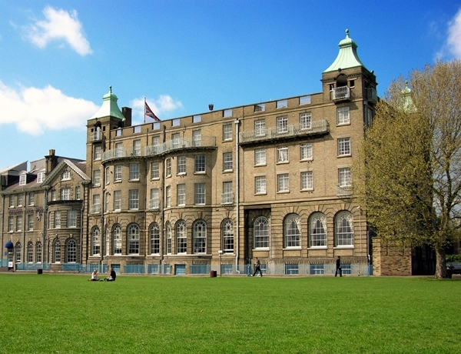
Notes:
And this is how we started, with an offsite meeting in this hotel.
Our product manager had done some initial research and he pitched us the idea of… (explain what the tool does)
Analogy of how we are similar to and differ from the ALM tool Octopus Deploy (introduce the DLM acronym)
Now, the idea had come from talking to Redgate’s current market, which comes with a massive advantage: we already understood that market to some degree already, although obviously we didn’t know precisely how it related to this new tool idea, so we had some work to do…

Slide 10
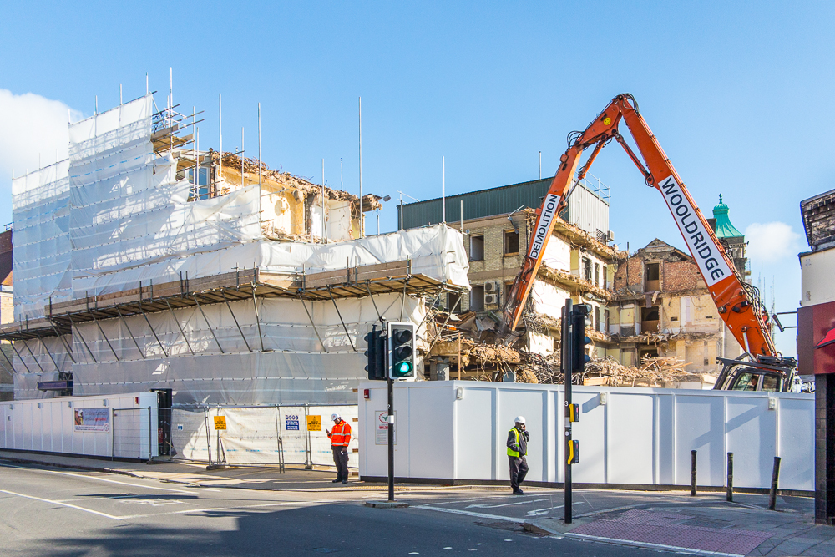
Notes:
now demolished
bad omen joke

Slide 11
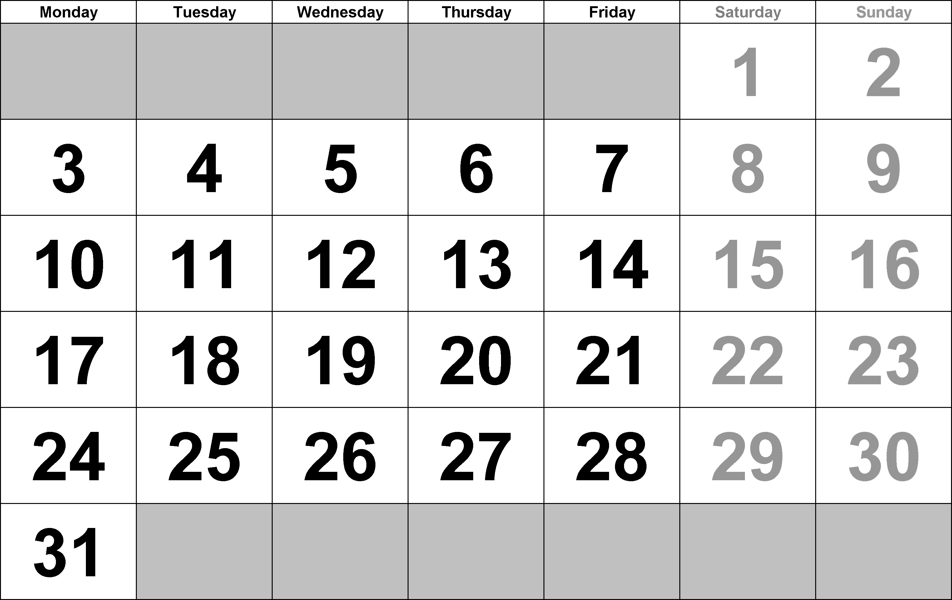
Notes:
The offsite meeting was on Wednesday 12th March 2014.
And we decided to get our ideas in front of as many people as possible as quickly as possible.
In the first week of April there was a conference called ALM Forum in Seattle, which we thought would contain a bunch of interesting people to talk to, so we booked plane tickets for Saturday 29th, leaving us just 2 and a half weeks to write what we were going to demo at the conference.

Slide 12

Notes:
Two and a half weeks later, the prototype was done, and off we flew!

Slide 13
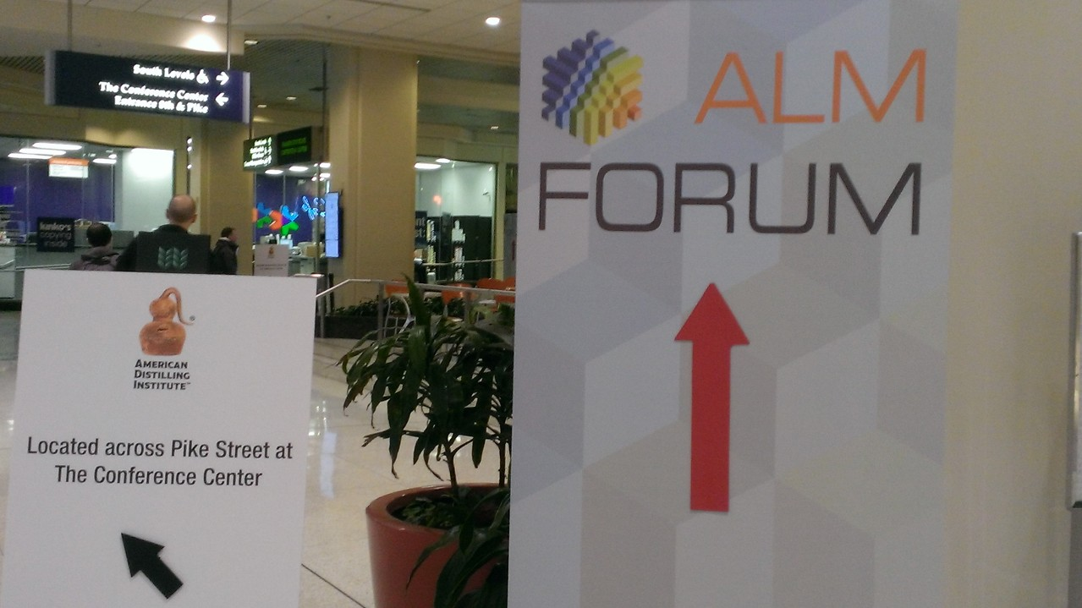

Slide 14
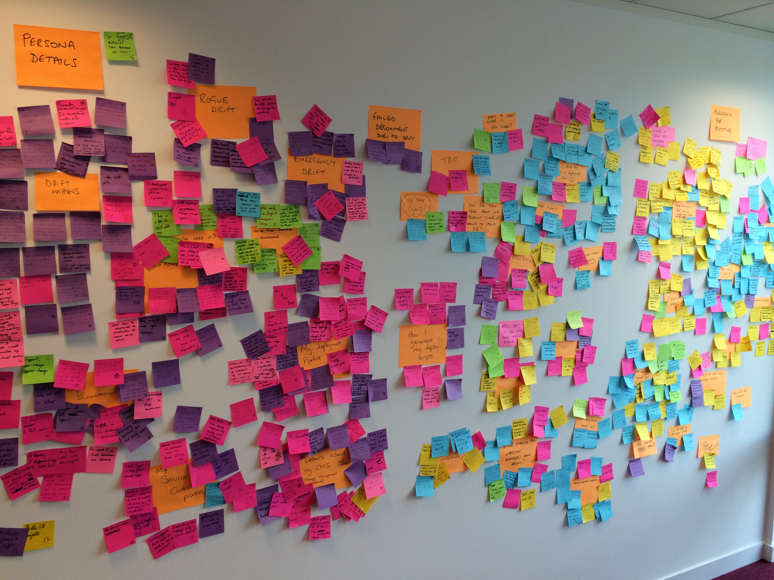
Notes:
We covered a wall in post-its, and here’s how we did it:
14 people
One hour:
During the call, we wrote down all of our notes onto individual post-its
First half, listened to them describing their job, explaining their current deployment process, and the pain points they had, etc…
Second half, we watched them using the prototype and conducted a UX test
Clustered the post-its, which forced us to think: did that person mean the same as this other person, etc…
https://twitter.com/cj_smithy/status/468076737155579904
Background of https://www.youtube.com/watch?v=VH0GkMNPsr4

Slide 15
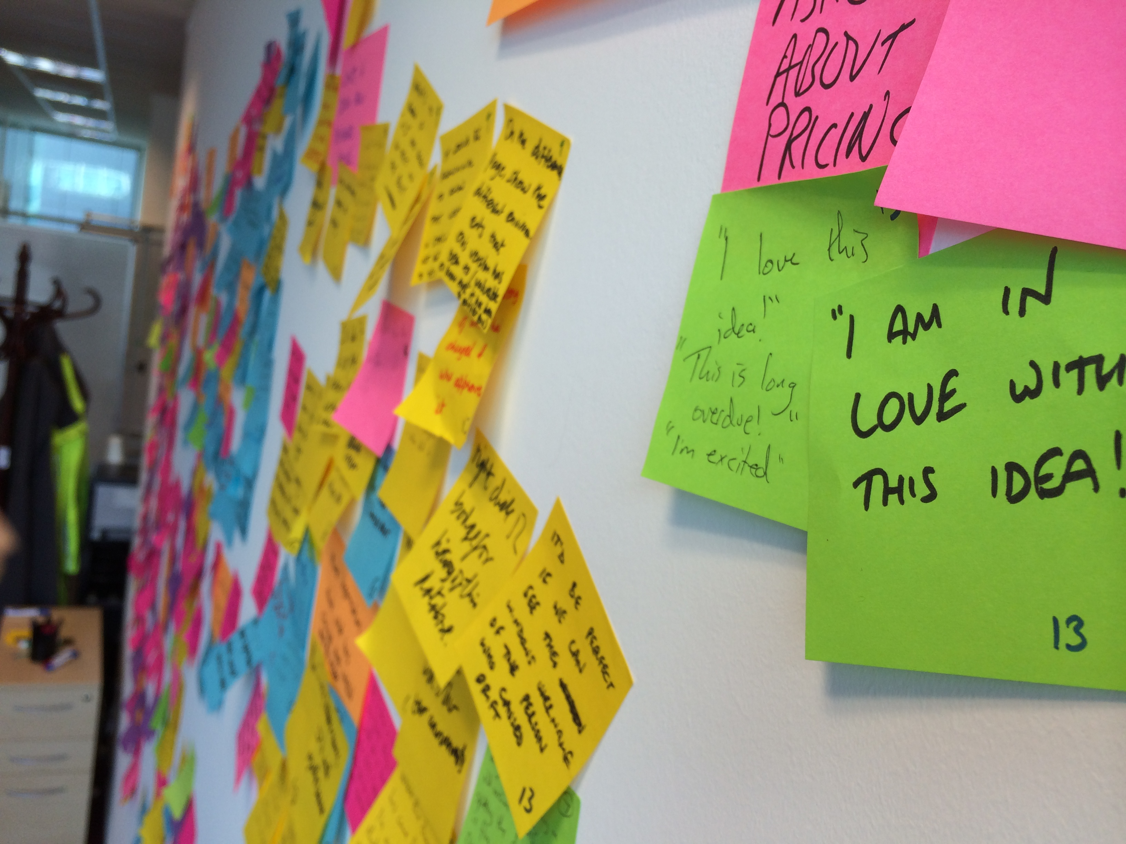
Notes:
“I am in love with this idea!”
“I love this idea!”
“This is long overdue!”
“I’m excited”
“Asked about pricing”

Slide 16
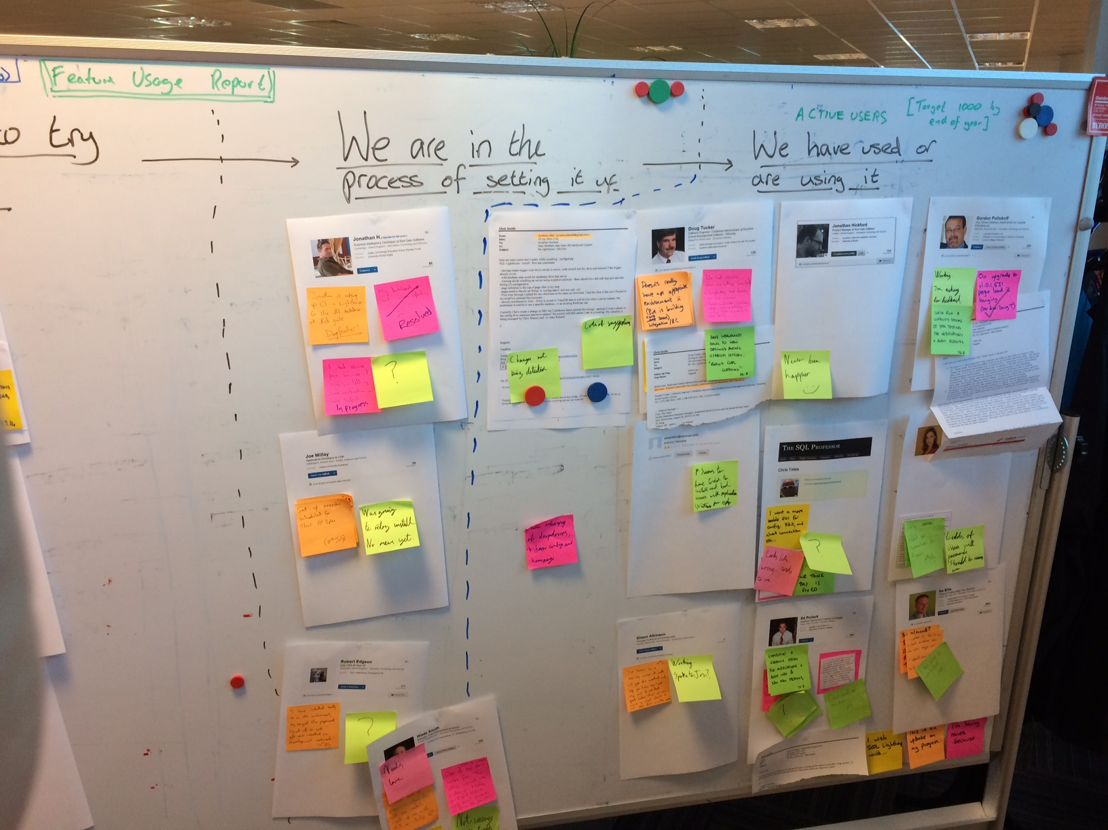
Notes:
After that extensive user research, the next stage of the project was a private alpha.
We started it with just 16 users, specially chosen to get a wide range of views.
Later on I’ll be talking about the open beta and how we did things differently for that.
Explain the board…
http://workingwithdevs.com/sql-lighthouse-account-of-agile-project/

Slide 17
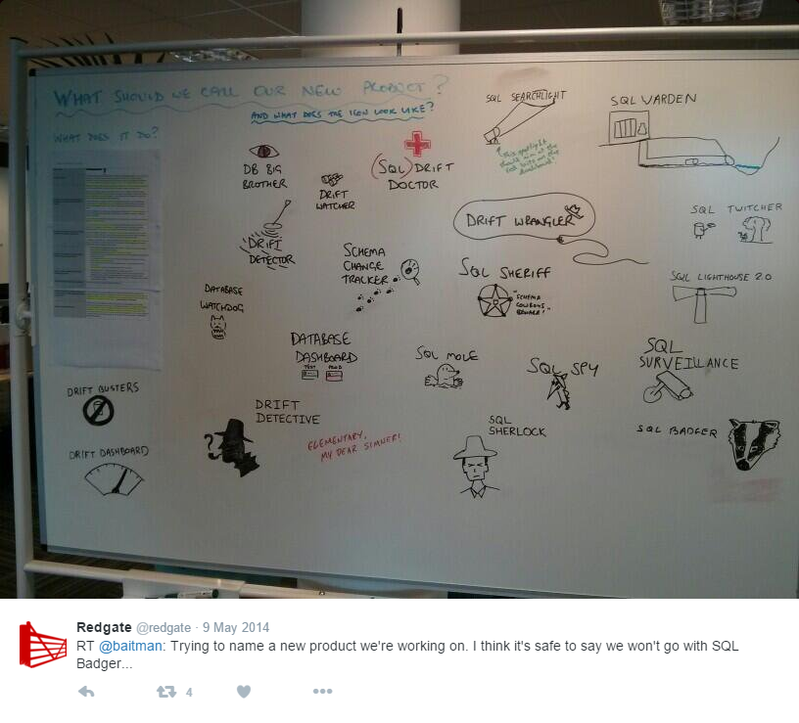
Notes:
This was our attempt to try to get feedback from people about what we should call the product.
We tweeted: “Trying to name a new product we’re working on. I think it’s safe to say we won’t go with SQL Badger…”
In hindsight, having some jokey names on there – like “SQL Badger” and “Drift Busters” meant that people replied with jokey names too, so we didn’t get any actionable feedback here.
It was fun, we had some buzz on social media about the project, but yeh, in hindsight, it wasn’t a useful way to get useful naming ideas.
We chose SQL Lighthouse as the name of the product, but that wasn’t based on any user feedback, and so later on, we ended up changing it…
The other piece of fun feedback we got was that the Easter Egg was too easy to find, so we changed what it was to hide it a bit better ☺
https://twitter.com/redgate/status/464762558562717696

Slide 18
/*
* Red Gate
* ____ ___ _ _ _ _ _ _
* / ___| / _ \ | | | | (_) __ _ | |__ | |_ | |__ ___ _ _ ___ ___
* \___ \ | | | || | | | | | / _` || '_ \ | __|| '_ \ / _ \ | | | |/ __| / _ \
* ___) || |_| || |___ | |___ | || (_| || | | || |_ | | | || (_) || |_| |\__ \| __/
* |____/ \__\_\|_____| |_____||_| \__, ||_| |_| \__||_| |_| \___/ \__,_||___/ \___|
* |___/
*
* For information about this object, see: http://www.red-gate.com/sql-lighthouse/ddl-trigger
*
* If you have any problems, or need to change this object, we really want to know,
* please email us at: dbdashboardsupport@red-gate.com
*
* Copyright © Red Gate Software Ltd. 2014
*/
CREATE TRIGGER RG_SQLLighthouse_DDLTrigger
ON ALL SERVER
WITH EXECUTE AS SELF
AFTER DDL_EVENTS
AS
...
Notes:
A part of our installation involved installing a DDL Trigger on SQL Server.
We were very keen to get any feedback if that DDL Trigger negatively impacted the SQL Server in any way, so we put a comment at the top of it, with an email address for people to get in touch with us.
Obviously, the alpha users all knew about the trigger, but someone else in their organisation might not be aware, so this was a very convenient way of informing other people who might use that SQL Server about what that trigger was all about.

Slide 19
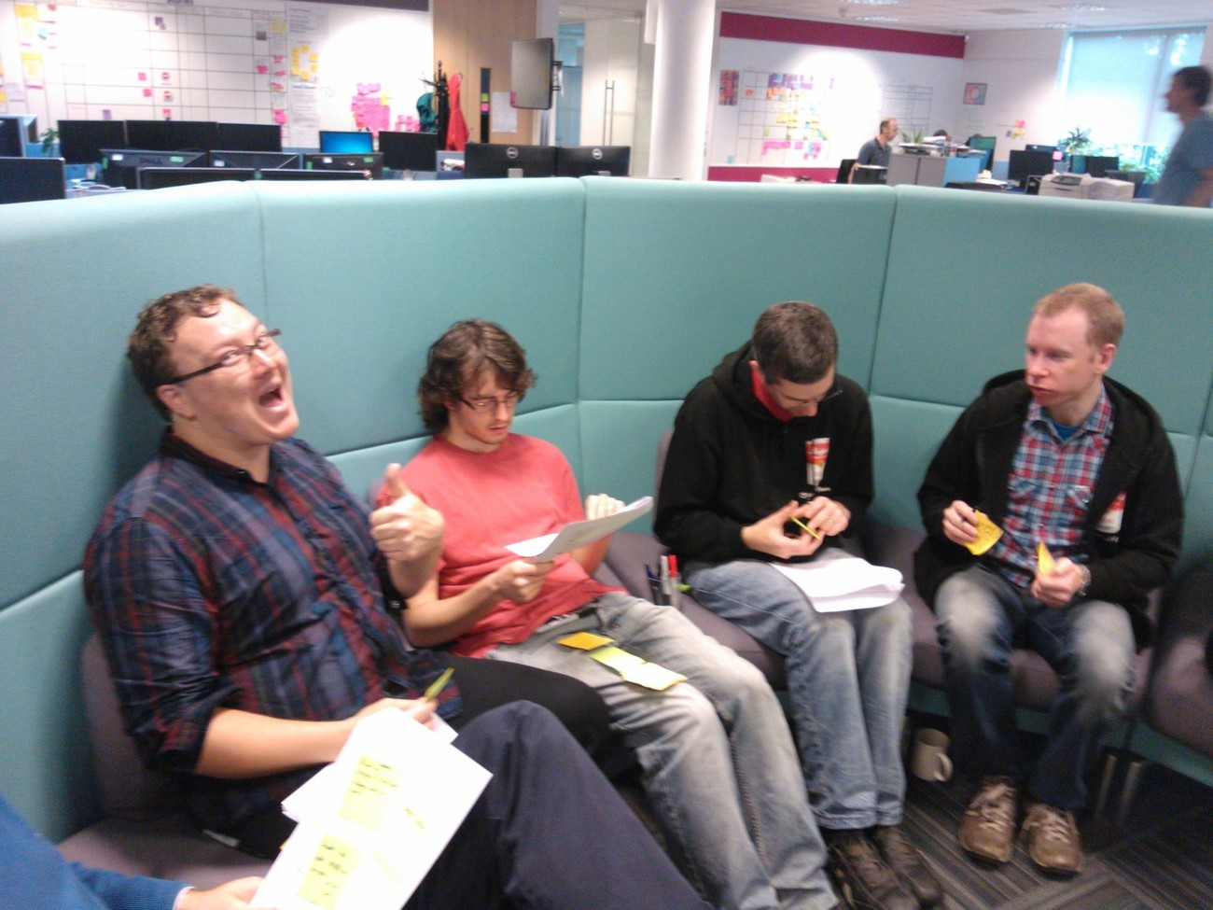
Notes:
In the final few weeks of the private alpha, we were fretting about what would happen when we released our public beta, so we decided to find out in a low risk way.
We invited a new small cohort of users to join our private alpha, and our UX designer asked them to keep a journal about all their interactions with the software, from installation, to the first-run experience, to configuration, and finally through to the day-to-day use.
The users sent us these journals, and rather than our UX designer reading through them and giving the team a summary, instead he got us to read them, which you can see in this photo.
Now he didn’t do this because he was lazy, he did this to help us empathise with the struggles that these users faced, so we’d read about it first hand, and could come up with improvements to the product to fix these niggles. Also, by reading about their struggles first hand, and hearing how some aspects of our tool were really difficult to set up, we decided to prioritise these UX fixes over any new features that our alpha users were asking for.
http://www.touchdeluxe.co.uk/when-ux-feedback-becomes-project-critical/

Slide 20
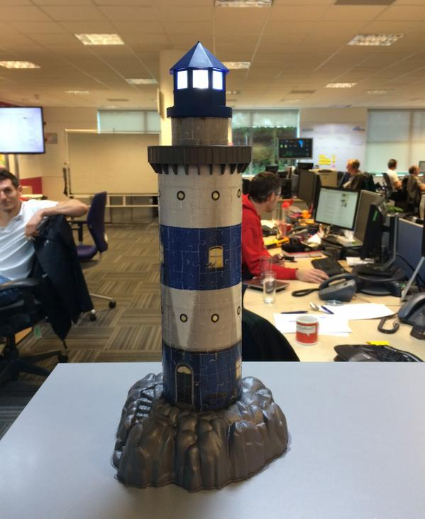
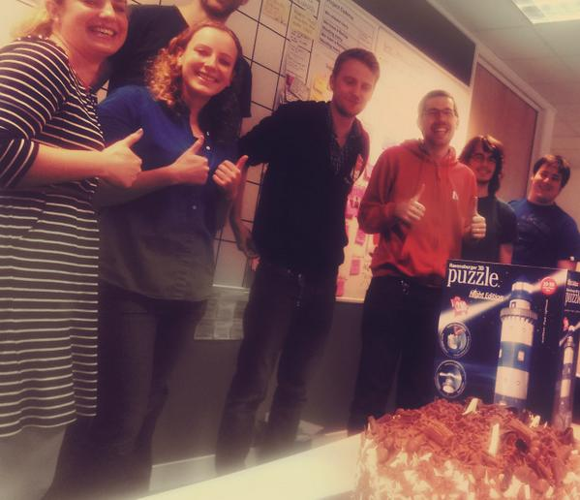
Notes:
And a week later, once we’d put those usability improvements in, we shipped our public beta!
https://twitter.com/cj_smithy/status/525225853253586944
https://twitter.com/_AlexYates_/status/525279632158121984
https://twitter.com/cj_smithy/status/525666119689179137

Slide 21


Notes:
And now I’m going to talk about what happened during the public beta.
The main difference between the private alpha and the public beta, was that the public beta had way way more people using it.
And that meant we had to scale how we collected feedback.
We still kept the individual touch, but now it was with a sample of the users rather than every one, because obviously we couldn’t talk to each user individually now there were so many.
We also introduced some new techniques to analyse the users in aggregate, which we’ll see, for example UserVoice and using Google Analytics.

Slide 22
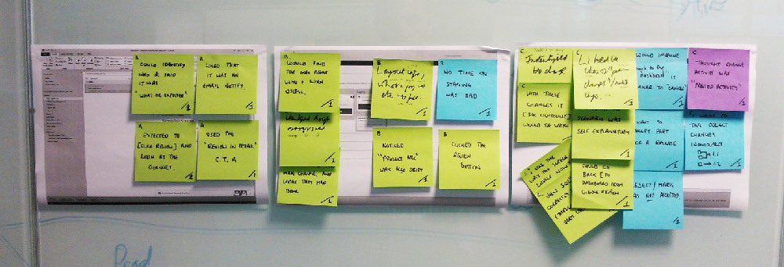
Notes:
UX tests were one of the ways we kept the individual touch.
We chose a small number of users and invited them to participate.
We also incentivized them with Amazon vouchers.
How we ran UX tests…
During the call, we wrote down all of our notes onto individual post-its, and stuck them onto the bit of the UI they corresponded to
http://www.touchdeluxe.co.uk/try-compiling-research-at-collection/

Slide 23
Scaling feedback
Auto emails
Surveys
UserVoice
Support rota
In-product support system
Notes:
We used HubSpot to send our auto emails. They were sent with our Product Manager’s name & email address, and asked things like “what are you hoping to achieve with the tool”, etc…
When we started work on a feature from UserVoice we got in touch individually with the people who voted for it to ask them for more details, invite them to a UX session, etc…
We had a support rota and we even included everybody on the team on that rota, not just the developers. If the person on the rota couldn’t answer the support issue, they were responsible for making sure somebody else on the team answered it. Having, for example, our UX person on the rota was great for getting him to be aware of the issues our users were facing. He also discovered something, once you’ve answered a user’s support issue, that is a great time to ask them for something, they’re engaged and happy, and they were generally really happy to help by answering the odd question about the feature he was designing at the time!
When a support issue came in, we could ask the user to type a special keyboard shortcut in the product that would allow them to send logs through to us. This saved us time in getting the right information from users, and let us fix support issues faster.
http://www.touchdeluxe.co.uk/lean-user-research/

Slide 24

October | November | December | January
February | March | April | May
M | T | W | T | F | S | S
 |  | 1 | 2 | 3 | 4 | 5
6 | 7 | 8 | 9 | 10 | 11 | 12
13 | 14 | 15 | 16 | 17 | 18 | 19
20 | 21 | 22 | 23 | 24 | 25 | 26
27 | 28 | 29 | 30 | 31
M | T | W | T | F | S | S
 |  |  |  |  | 1 | 2
3 | 4 | 5 | 6 | 7 | 8 | 9
10 | 11 | 12 | 13 | 14 | 15 | 16
17 | 18 | 19 | 20 | 21 | 22 | 23
24 | 25 | 26 | 27 | 28 | 29 | 30
M | T | W | T | F | S | S
1 | 2 | 3 | 4 | 5 | 6 | 7
8 | 9 | 10 | 11 | 12 | 13 | 14
15 | 16 | 17 | 18 | 19 | 20 | 21
22 | 23 | 24 | 25 | 26 | 27 | 28
29 | 30 | 31
M | T | W | T | F | S | S
 |  |  | 1 | 2 | 3 | 4
5 | 6 | 7 | 8 | 9 | 10 | 11
12 | 13 | 14 | 15 | 16 | 17 | 18
19 | 20 | 21 | 22 | 23 | 24 | 25
26 | 27 | 28 | 29 | 30 | 31
M | T | W | T | F | S | S
 |  |  |  |  |  | 1
2 | 3 | 4 | 5 | 6 | 7 | 8
9 | 10 | 11 | 12 | 13 | 14 | 15
16 | 17 | 18 | 19 | 20 | 21 | 22
23 | 24 | 25 | 26 | 27 | 28
M | T | W | T | F | S | S
 |  |  |  |  |  | 1
2 | 3 | 4 | 5 | 6 | 7 | 8
9 | 10 | 11 | 12 | 13 | 14 | 15
16 | 17 | 18 | 19 | 20 | 21 | 22
23 | 24 | 25 | 26 | 27 | 28 | 29
30 | 31
M | T | W | T | F | S | S
 |  | 1 | 2 | 3 | 4 | 5
6 | 7 | 8 | 9 | 10 | 11 | 12
13 | 14 | 15 | 16 | 17 | 18 | 19
20 | 21 | 22 | 23 | 24 | 25 | 26
27 | 28 | 29 | 30
M | T | W | T | F | S | S
 |  |  |  | 1 | 2 | 3
4 | 5 | 6 | 7 | 8 | 9 | 10
11 | 12 | 13 | 14 | 15 | 16 | 17
18 | 19 | 20 | 21 | 22 | 23 | 24
25 | 26 | 27 | 28 | 29 | 30 | 31
Notes:
One of the best ways to get feedback on some code you’ve written, is to ship it.
So we did.
Pretty much every single Wednesday.
The public beta started in October 2014, and lasted 7 months until May 2015, when we came out of beta and became a free tool.
All the dates we shipped are highlighted, and you can see how good we got at shipping every Wednesday.
There’s a slight blip in April when we took 3 weeks to re-write our entire UI (and I’ll be going into more detail on our UI later in the talk).
http://leadingagileteams.com/2014/02/03/the-success-of-weekly-releases/
http://leadingagileteams.com/2015/03/13/release-wednesdays/

Slide 25
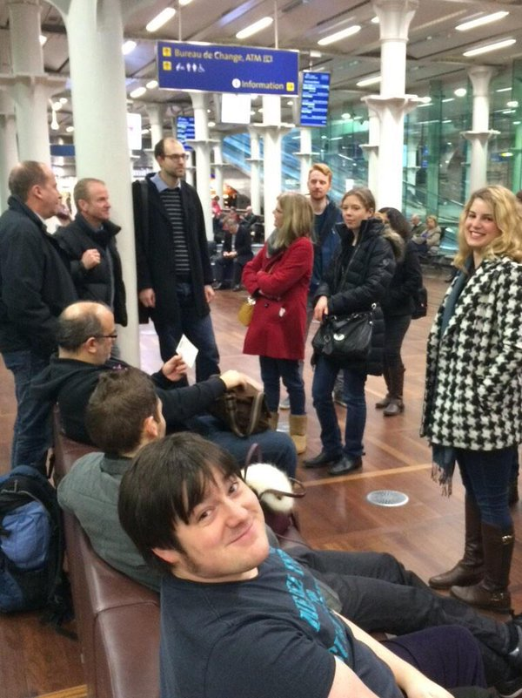
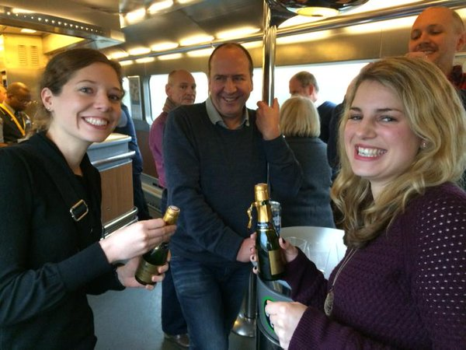
Notes:
In December, our team went on a day trip to Paris.
This is us at St Pancras station early in the morning, and also us having an apéritif on the Eurostar train going to Paris.
Now, the reason why I bring this up is that it was a Wednesday. And so we shipped. From Paris.
In other words, we got shipping down to just pressing a few buttons, so we could do it on our phones, over 3G and the VPN, from Paris.
We didn’t want our frequent releases to be a distraction, and so by automating all the tedious steps in releasing, they didn’t take that much of our time, letting us spend that time instead on more valuable things!
https://twitter.com/cj_smithy/status/540059176786214912
https://twitter.com/cj_smithy/status/540090681726091264
https://twitter.com/cj_smithy/status/540075507950571521
https://twitter.com/cj_smithy/status/540088522498396161
https://twitter.com/cj_smithy/status/540147306667196416

Slide 26
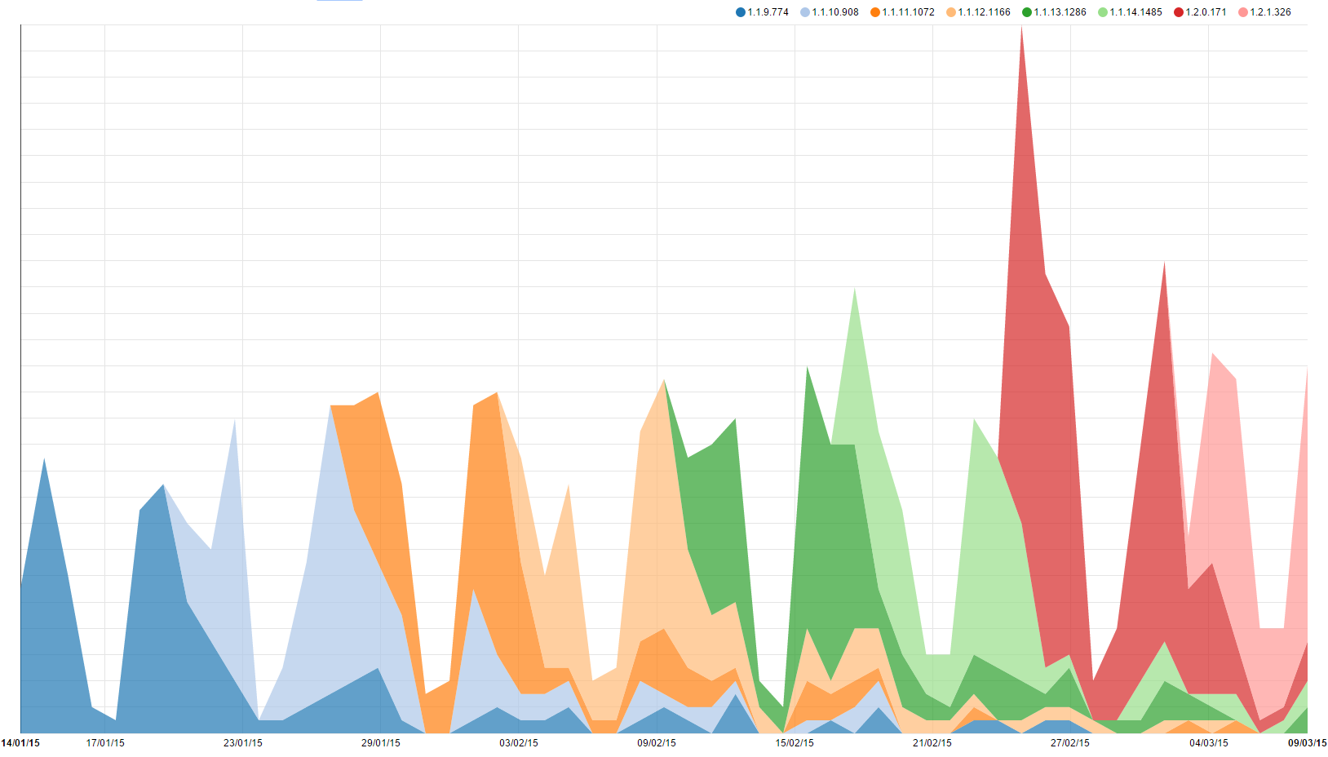
Notes:
Now because we are an on-premise product, we relied on people upgrading to use and give us feedback on the new features.
This is a graph showing how quickly people upgraded.
On the x-axis we have the date.
And on the y-axis we have the number of installs.
And the colours represent different versions.
We can see that the uptake of a new version is very quick, and old versions quickly get upgraded, which is really nice for us.
The lesson here is either make updates mandatory (like Google Chrome does), or just make the update notification super good at nagging the user until they upgrade (like we did).

Slide 27
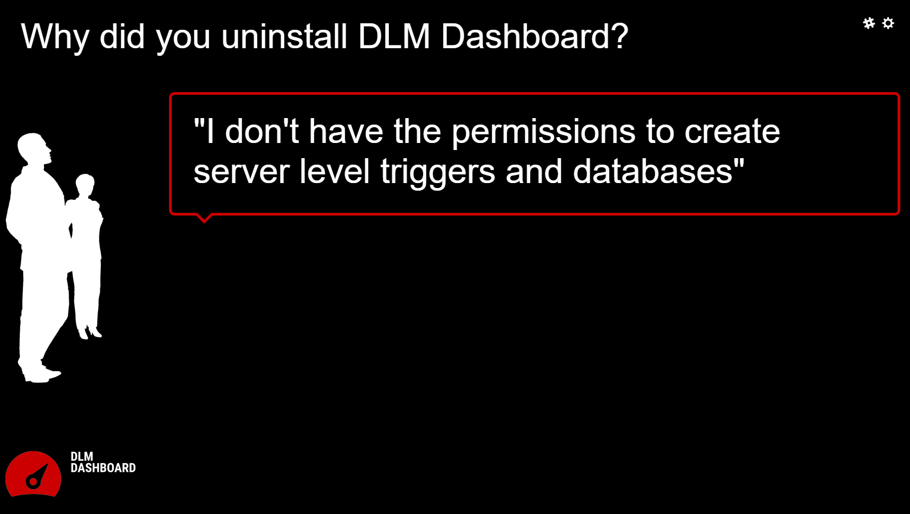
Notes:
When someone uninstalled the product, we popped up an uninstall survey, and if they filled it in, that was another place we got feedback from.

Slide 28
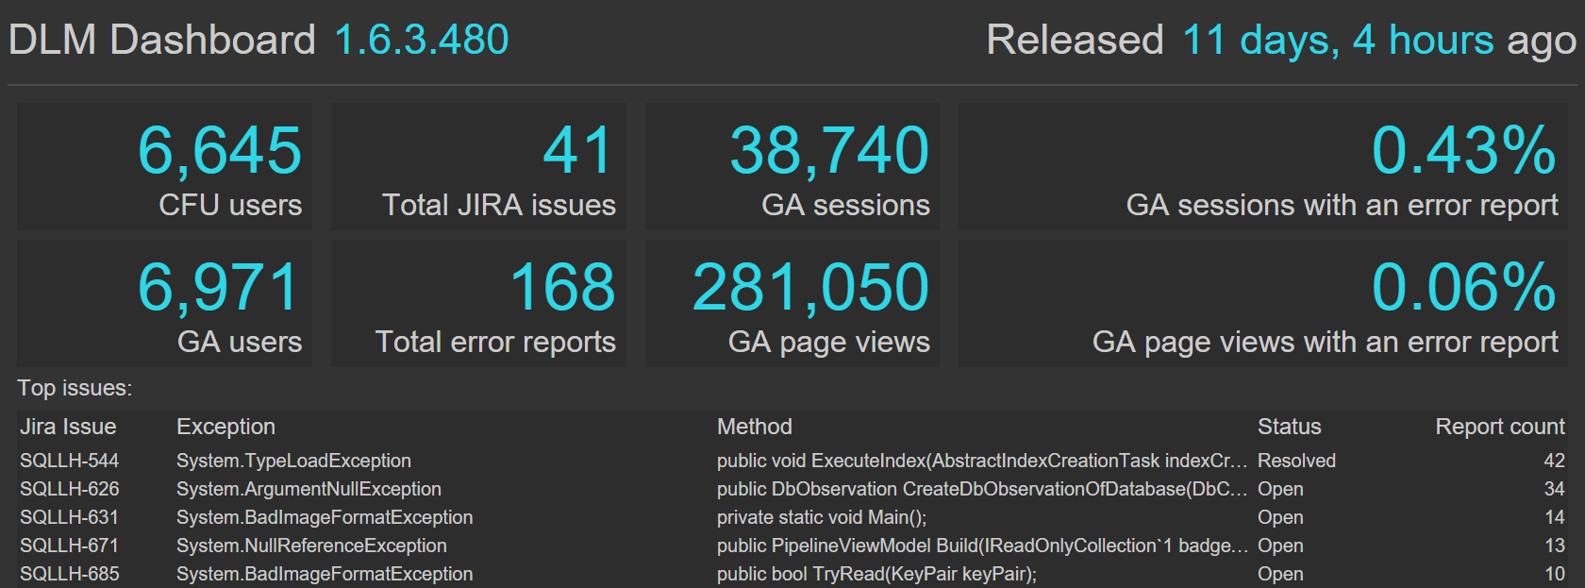
Notes:
We also built an automated error reporting system.
And then, to visualize that data we used an Early Warning System dashboard that as well as the automated error reports, also brought data together from several other places, so we could see at a glance how a particular build was getting on.

Slide 29
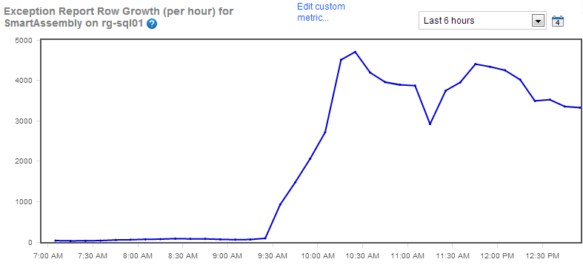
Notes:
There is such a thing as too much feedback – this is from the time we overwhelmed our automated exception reporting infrastructure!
That was not a good day…

Slide 30

Notes:
And finally, we also kept track of our usage metric.
Not just how many installations we had, but also, whether they were being used or not.
I’ve spent the last few slides talking about the areas where you often get the most negative feedback: uninstall surveys, exception reporting, and usage metrics.
You have to remember to ask yourself, who is the feedback coming from and is it representative of everyone – for example, if you’re solely focussing on the negative feedback you can easily overlook the silent majority who are in love with the tool.

Slide 31
UI changes
Added configuration
Notes:
Now we’re going to look at some concrete examples, and I’m going to be talking about these in a bit more depth than the things we’ve seen so far.
Firstly, let’s look at how we added configuration.

Slide 32
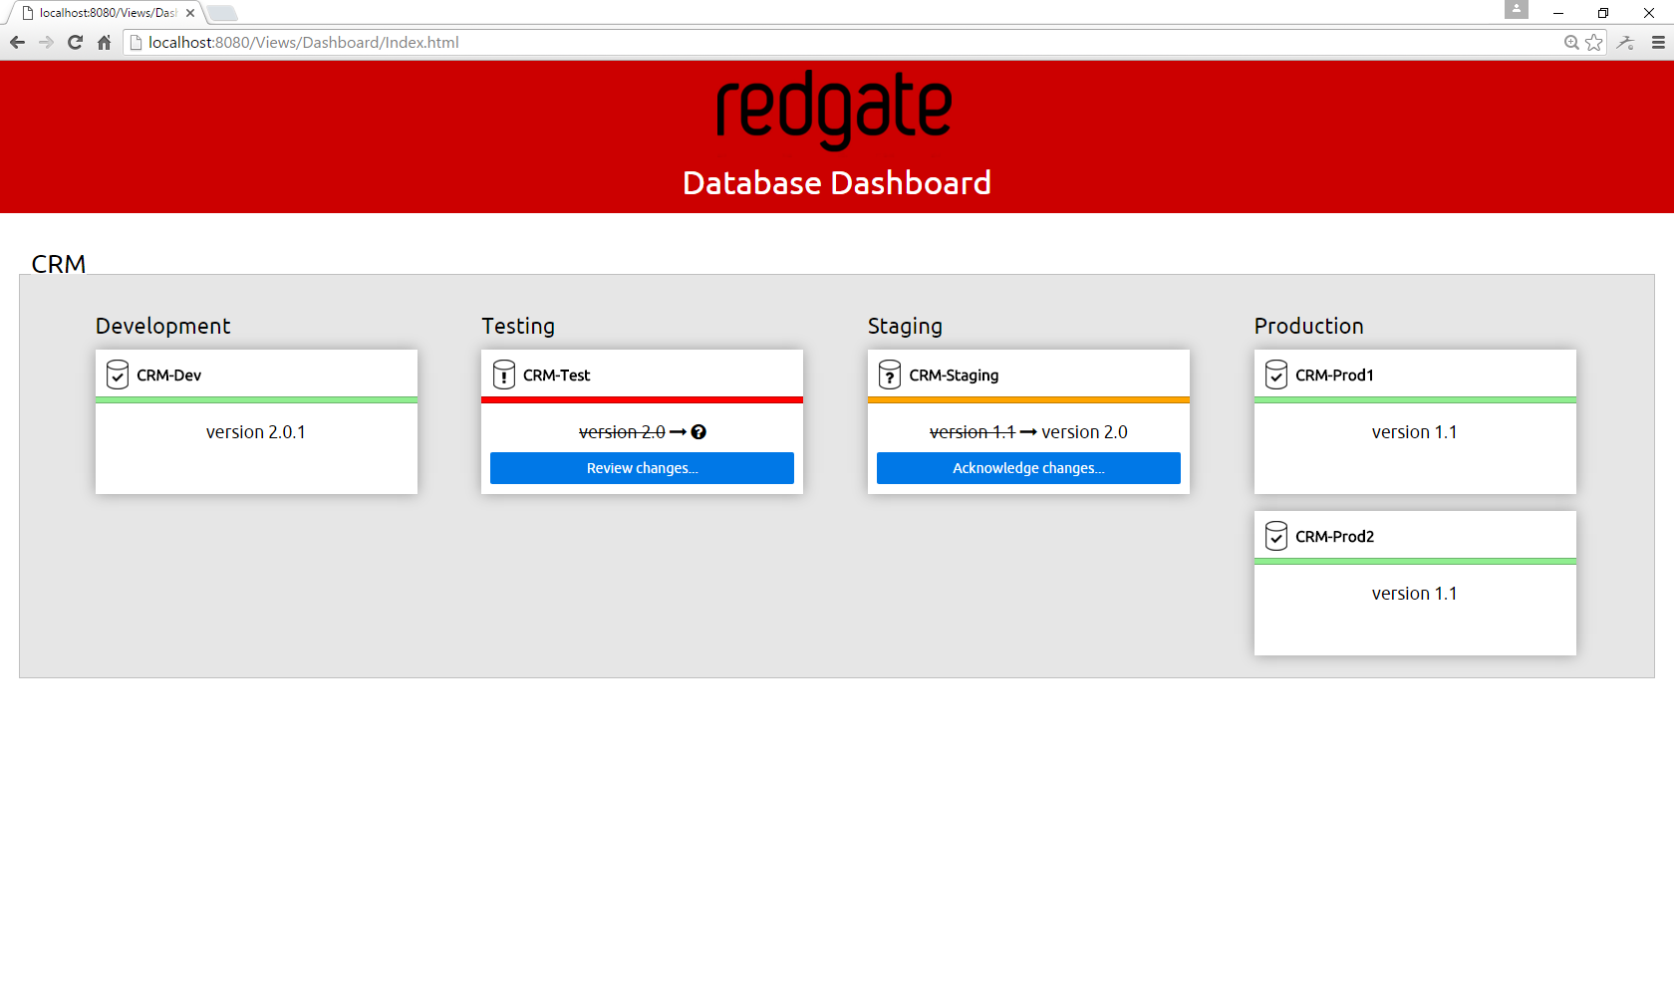
Notes:
This was the prototype that we took to ALM Forum.
It has no way of configuring it; there’s no installer; we literally ran it by pressing F5 in Visual Studio.
Clearly, we needed to make some changes before we shipped the private alpha, and the first of those was adding configuration…

Slide 33
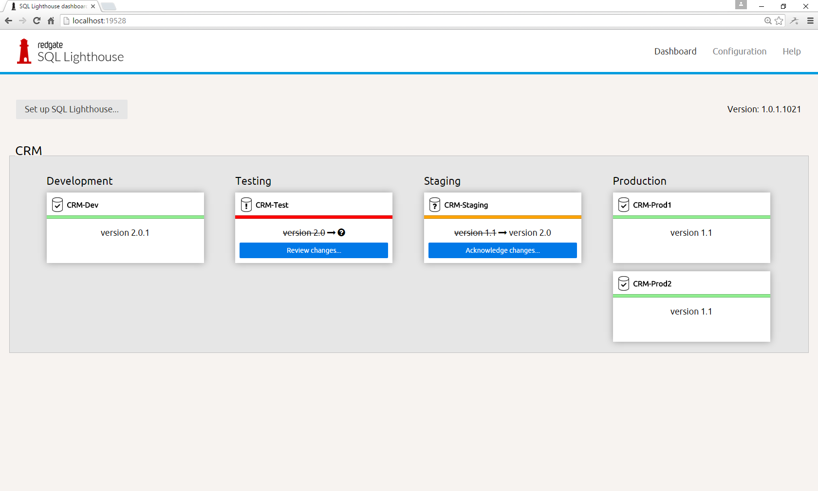
Notes:
There’s now a button “Set up SQL Lighthouse…”, and when you click it you get:

Slide 34
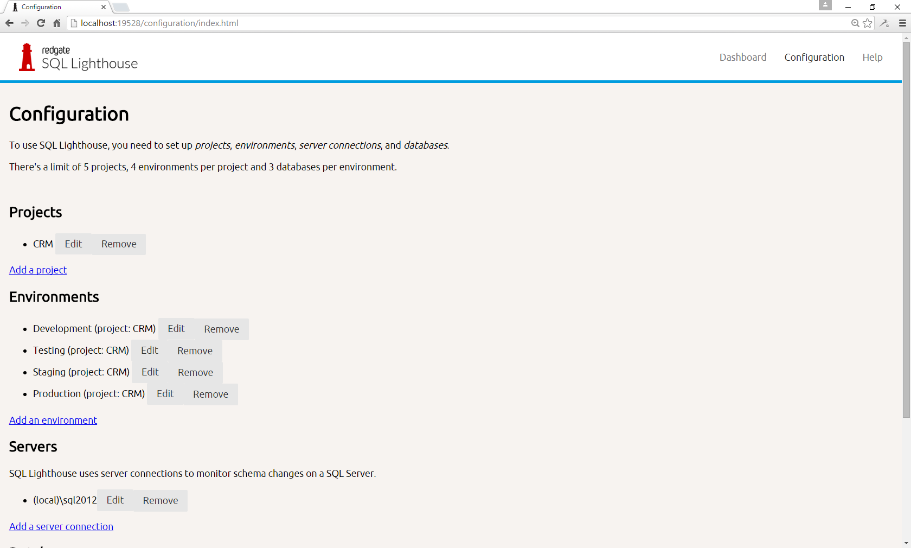
Notes:
This page.
Basic.
But it did the job.
It also looks like terribly bad.

Slide 35
UI changes
Added configuration
Improved styling
Notes:
We got feedback on just how bad it looks, so, before we could ship our public beta, we knew we had to improve the styling to make those pages look less terrible.

Slide 36
Notes:
From this…

Slide 37
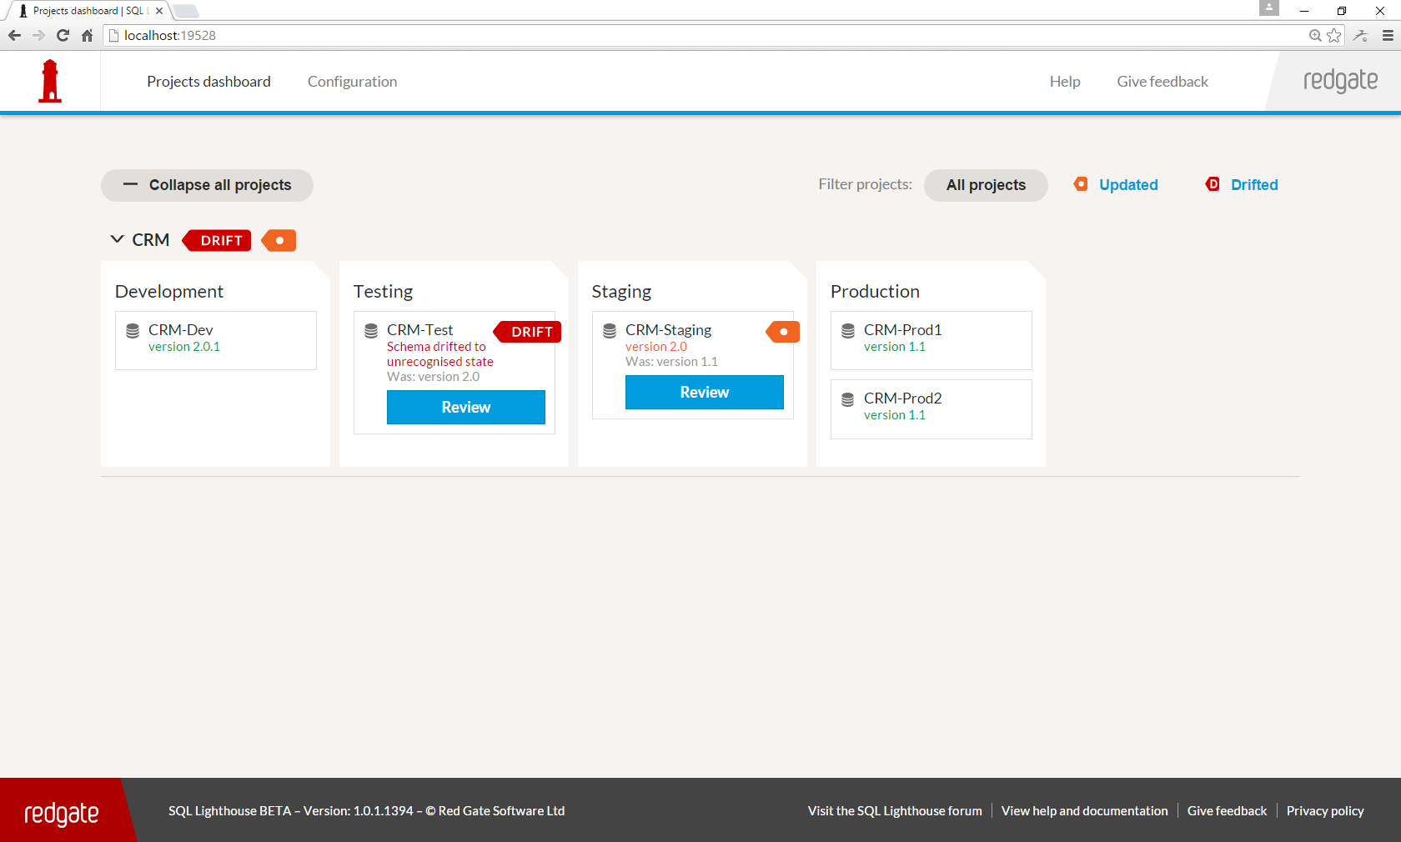
Notes:
To this…

Slide 38
Notes:
And there’s that setup page again. From that…

Slide 39
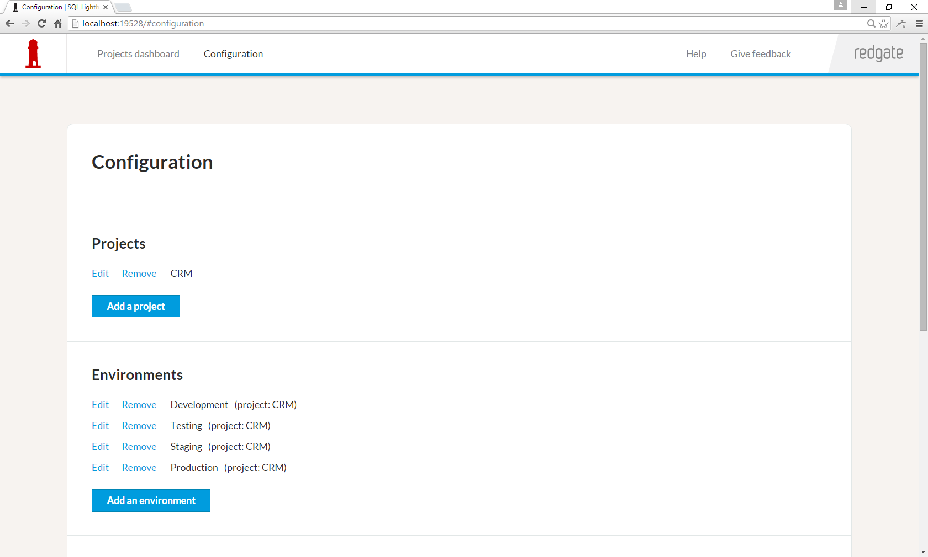
Notes:
To this…

Slide 40
UI changes
Added configuration
Improved styling
Funnel optimisations
Notes:
During the public beta, we used Google Analytics to analyse our conversion funnel from someone downloading the product through to becoming an active user. We spotted various points which weren’t performing well. So we fixed them. Let’s go through our configuration process as it was, and I’ll show you everywhere where they got stuck, and then we’ll see what we did about it.
http://www.touchdeluxe.co.uk/analysing-product-complexity/

Slide 41
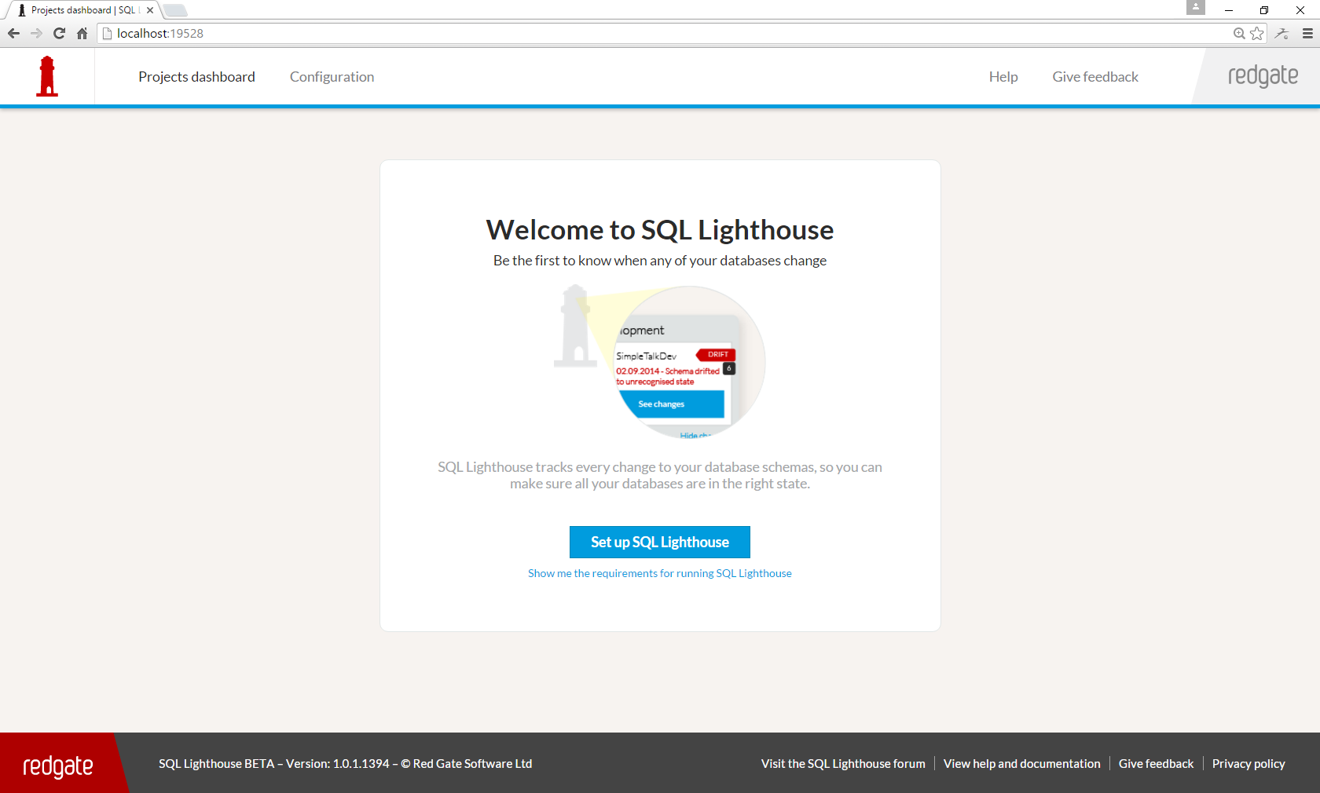
Notes:
Here we go. “Welcome to SQL Lighthouse”
This page was fine. They clicked the big blue button, just like we wanted them to.

Slide 42
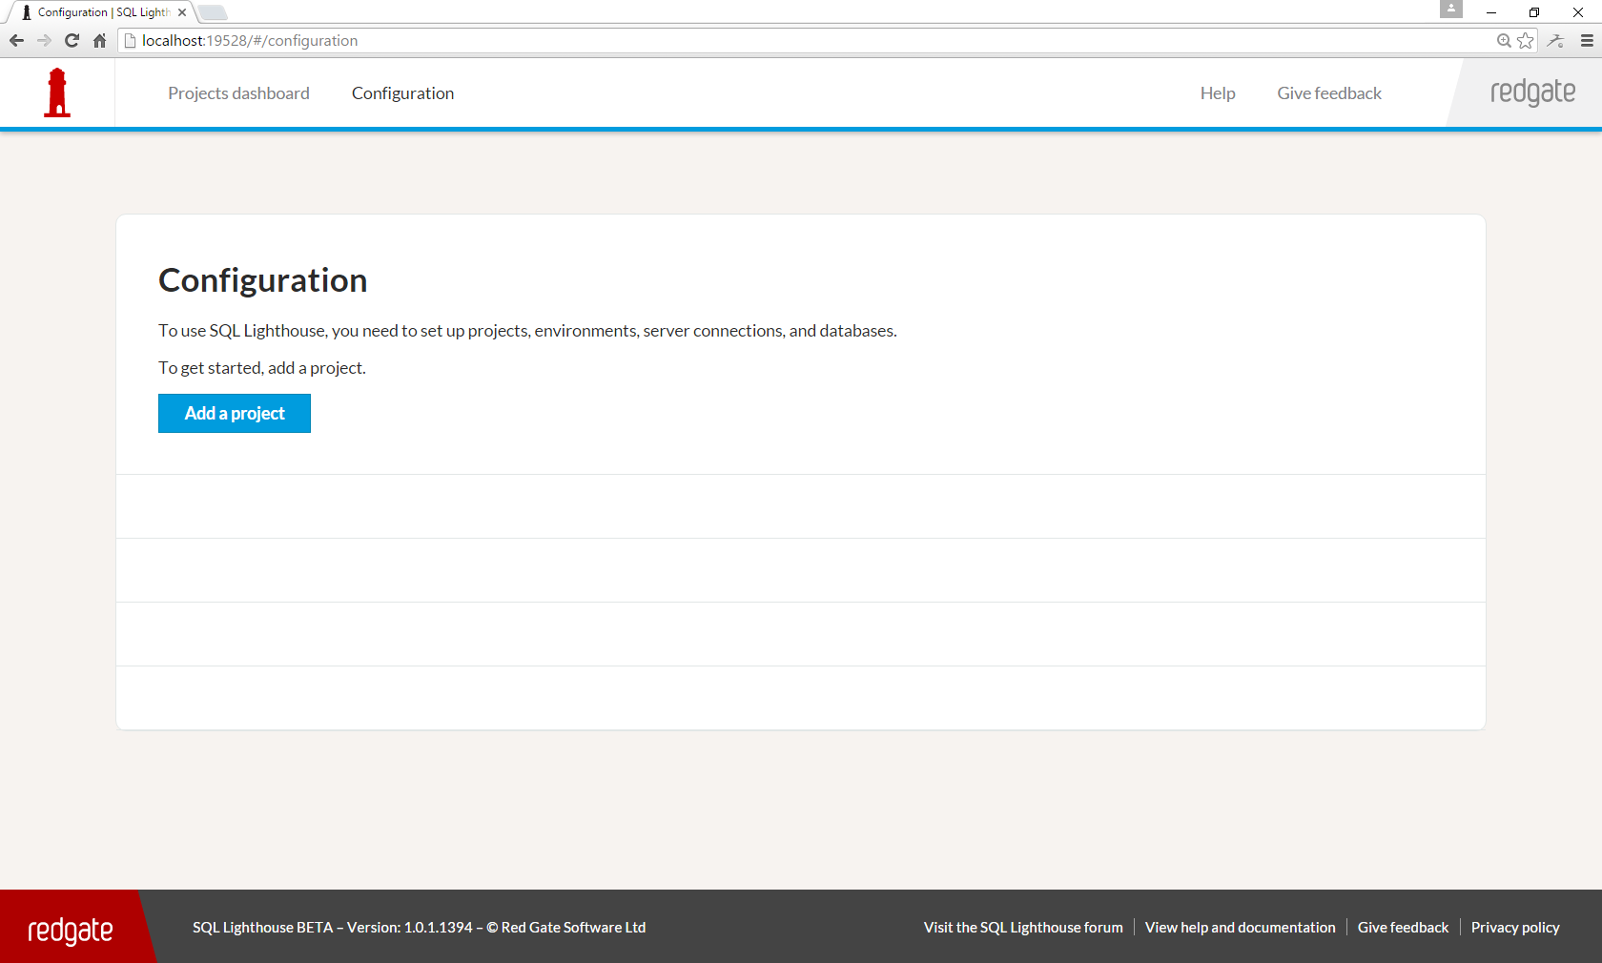
Notes:
Now, here’s the first struggle point. Projects.
Now for us, this made perfect sense. Reference Octopus Deploy.
But for users, they only wanted to monitor 1 or 2 databases, and maybe down the line they’d add more, but right now, they just wanted to try the product out.

Slide 43
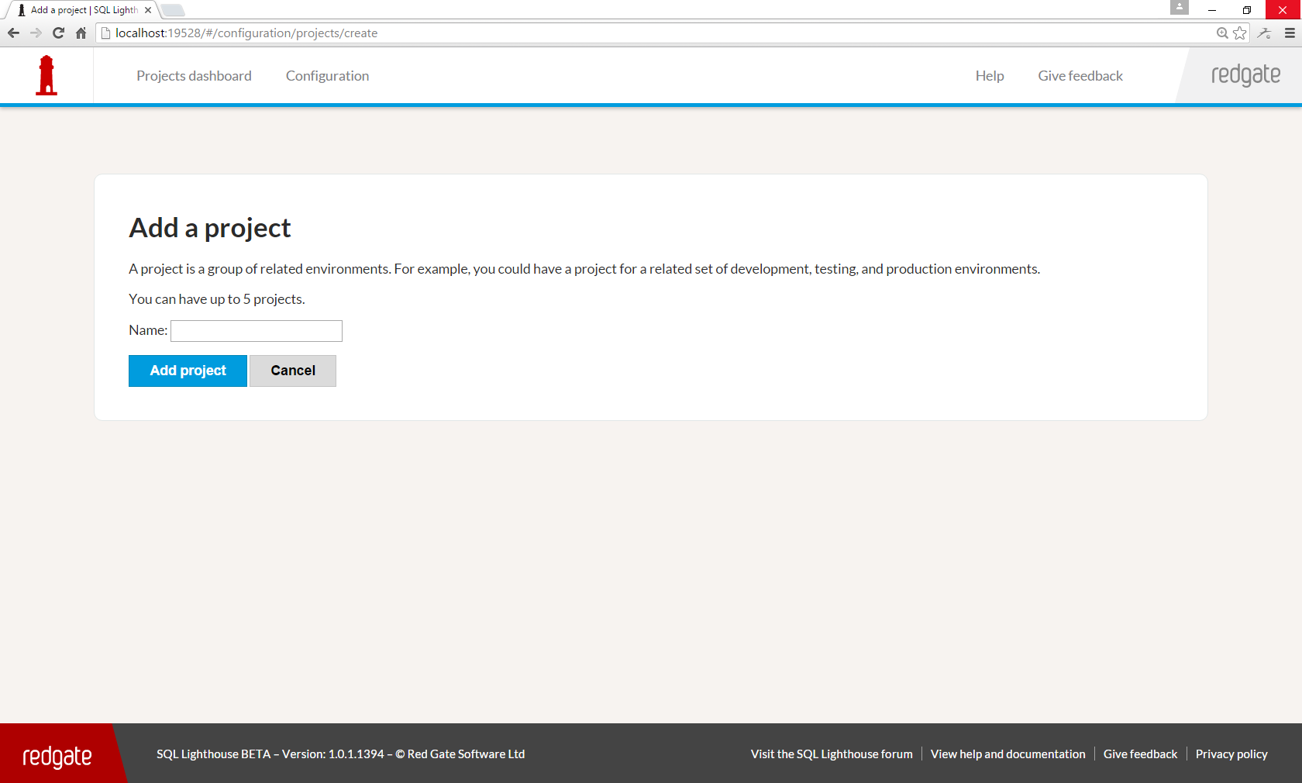
Notes:
Yep they had to create a project with a name.

Slide 44
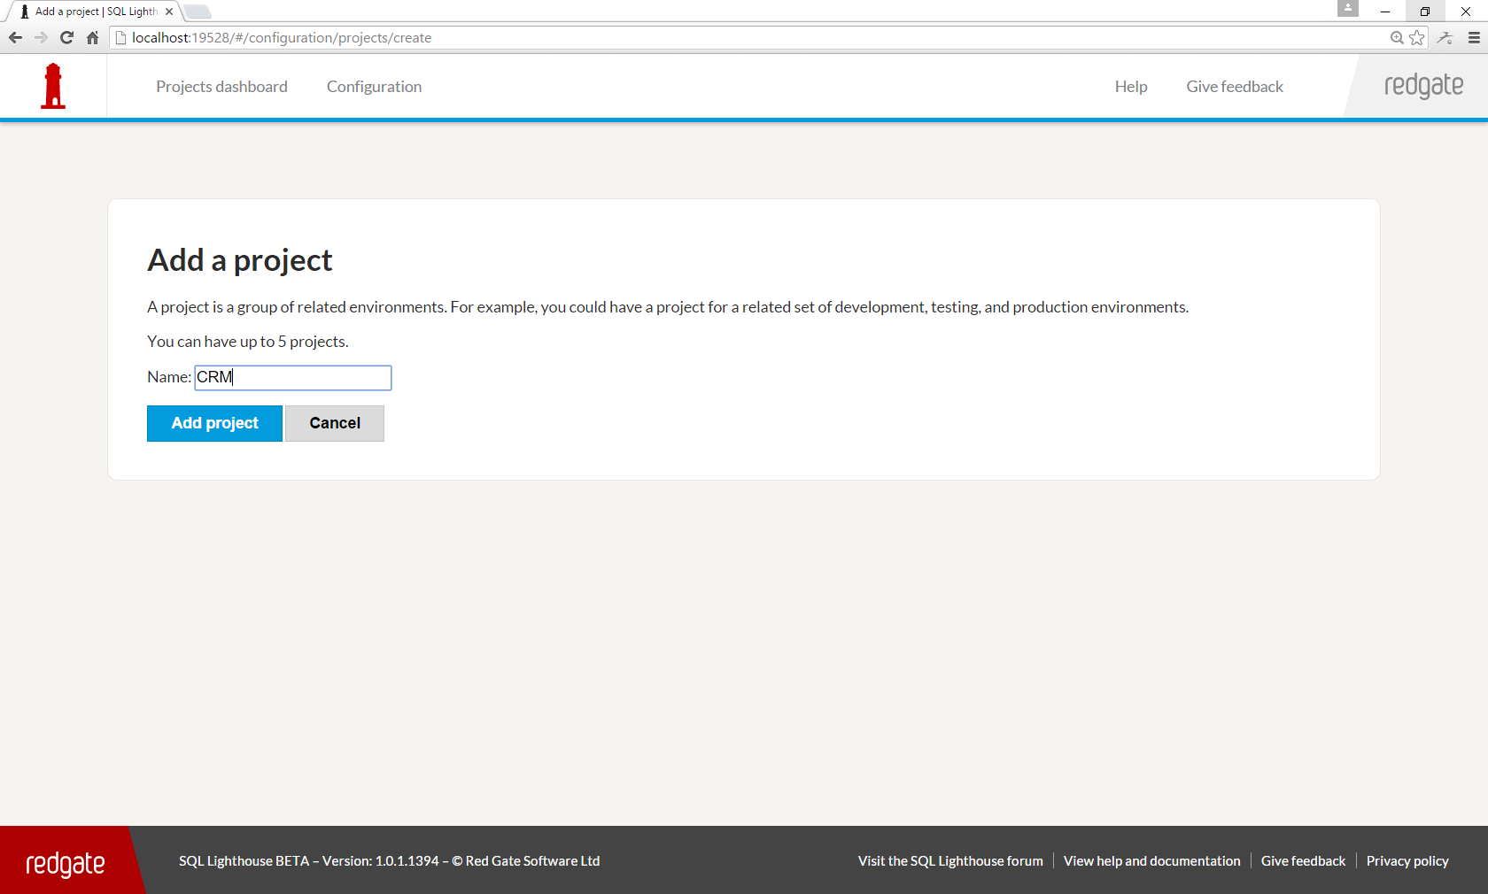
Notes:
So type something in there, and click the big blue button.

Slide 45
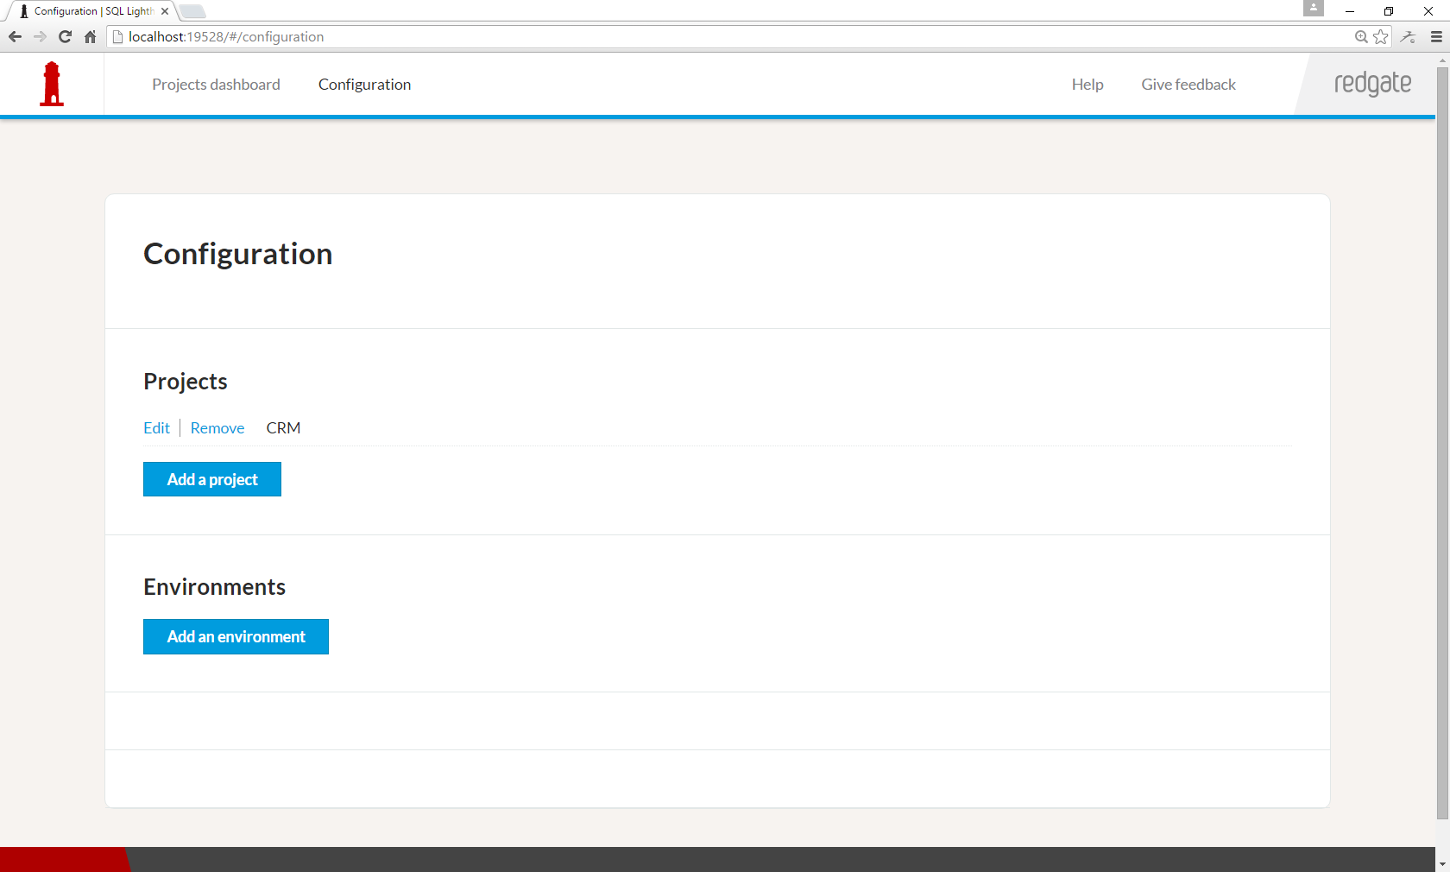
Notes:
Next up environments.

Slide 46
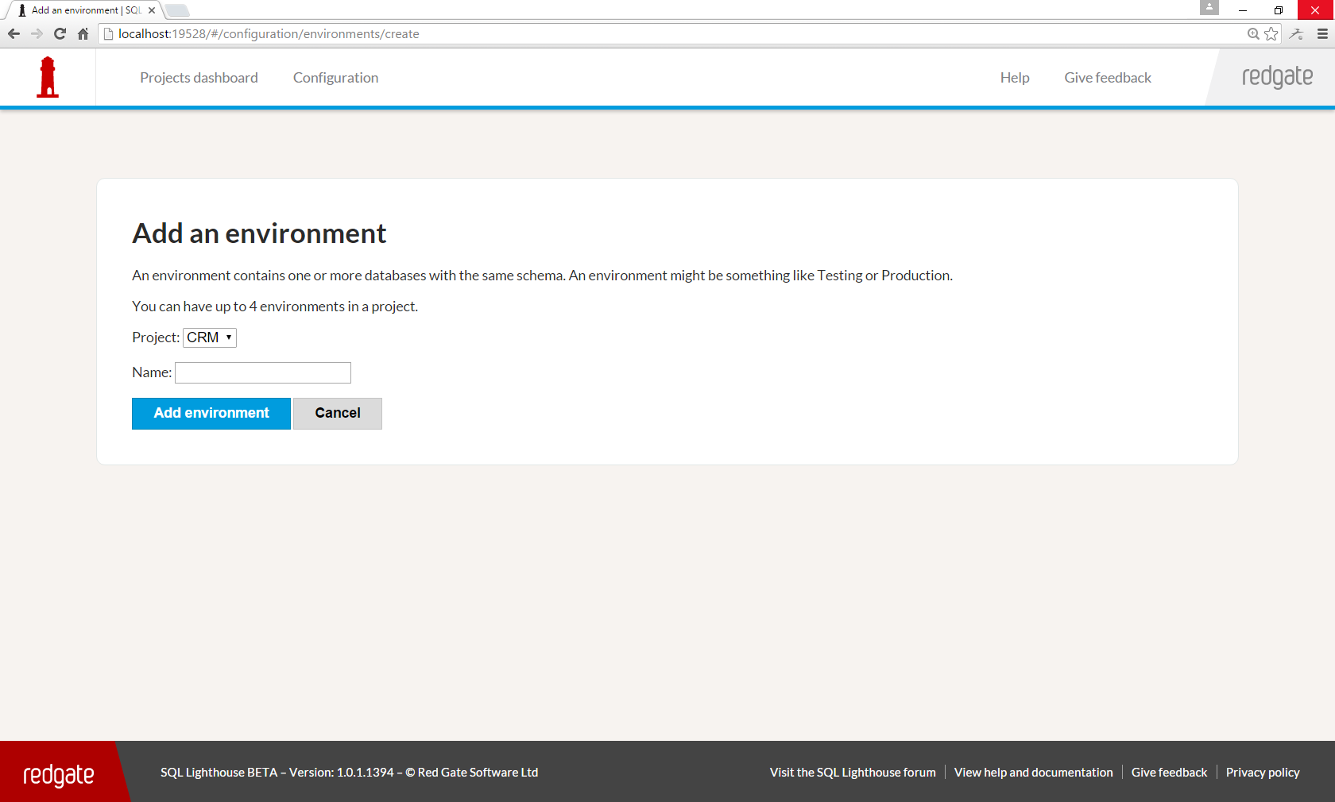
Notes:
Time to create one of those.

Slide 47

Notes:
Again, choose a name, type it in, and click the big blue button.

Slide 48
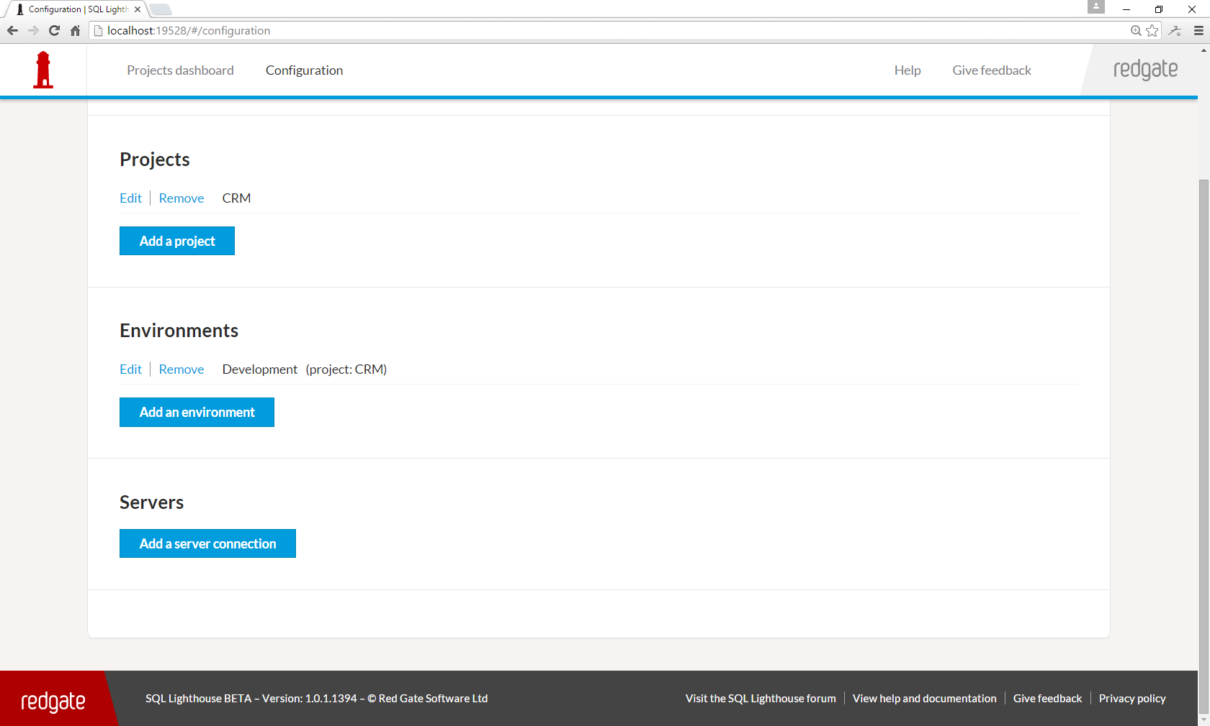
Notes:
“Finally, I can add a server. That’s what I wanted to do in the first place.”
Yep, that is a quote from one of our users. Projects and environments were hoops that we made them jump through, which they didn’t want. So we saw quite clearly in the Google Analytics funnel people were dropping out at every single one of those screenshots that I’ve just shown you.
Before we made a decision about what to do about this, we wanted more data.
We saw from the funnel data that some users had got past this step, so we asked those users who had got it configured to send us screenshots of their installation, so we could see how they configured it. Some had configured it how we intended, but lots hadn’t. Give examples. Mention limits side-stepping.
We thought the real value of the product was monitoring the test, staging, production databases and seeing where a version of the schema has got to in that lifecycle. It means you can answer questions like: where’s my bug fix gone? Has it been deployed to production yet? Etc…
Now, some customers did do that, but lots just wanted to monitor 1 or maybe 2 databases, and projects and environments were getting in the way for them.
Essentially, we had two groups of users with different demands from the product, and we’d designed it solely for one of those groups.
In hindsight, we should have had a UX designer from the beginning and we very quickly got one assigned to our project after this!
We’ll see what we did about this in a minute, but let’s just go through the other issues first.

Slide 49
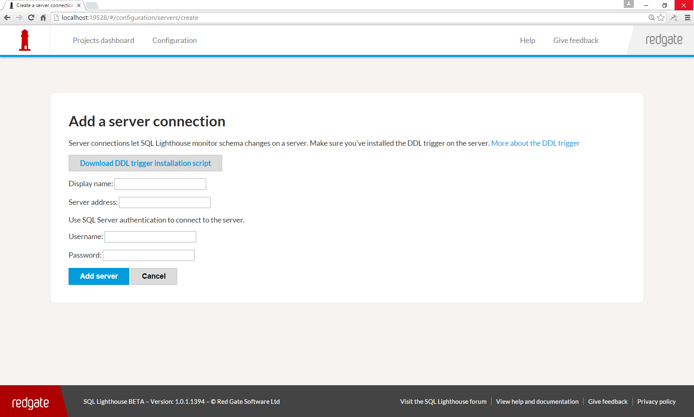
Notes:
To add a server, they had to download and run a SQL script to add a DDL Trigger to their SQL Server. People dropped out here too.

Slide 50
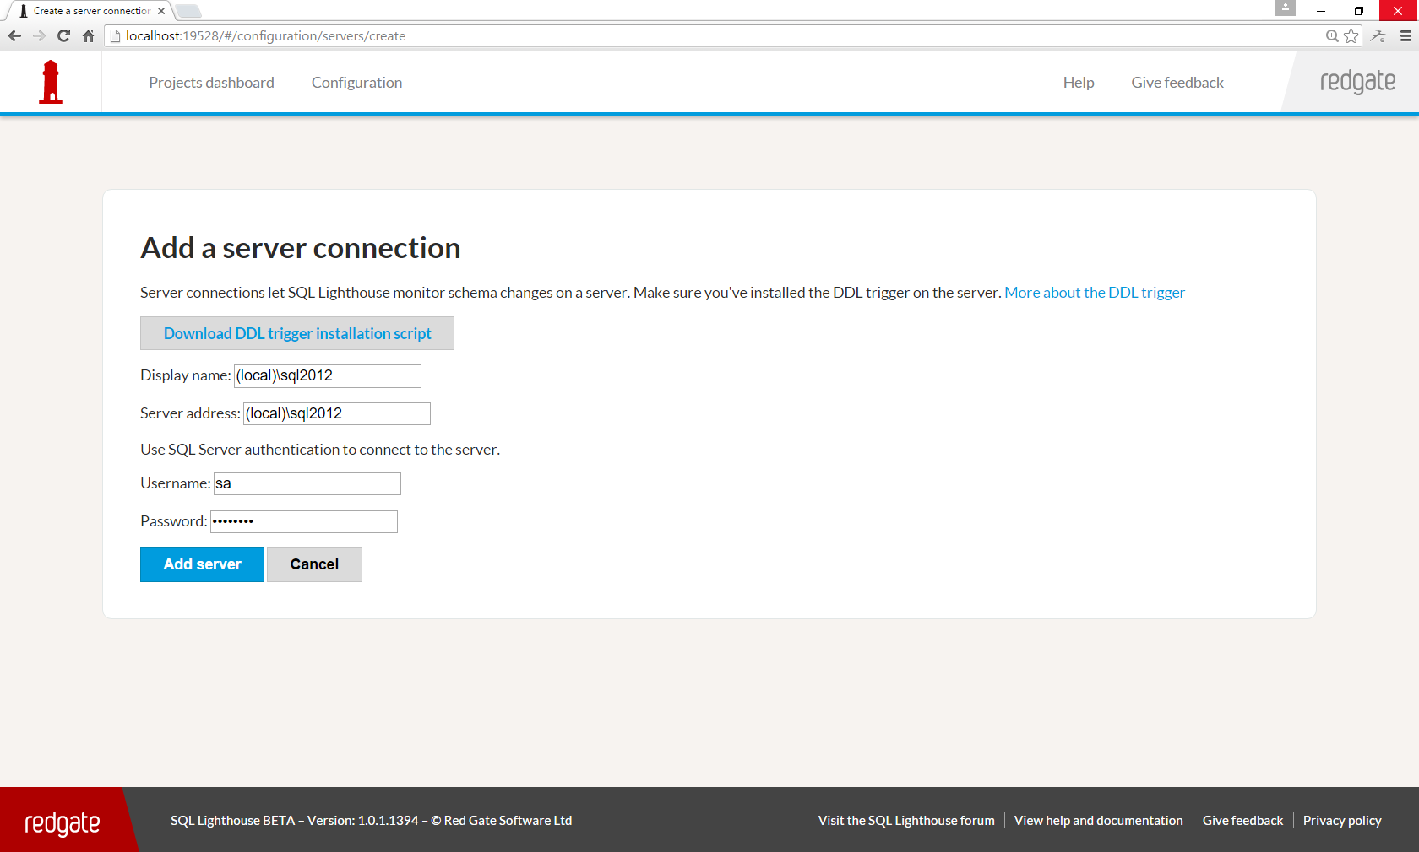
Notes:
They also got confused about what the difference between the display name and the server address was.

Slide 51
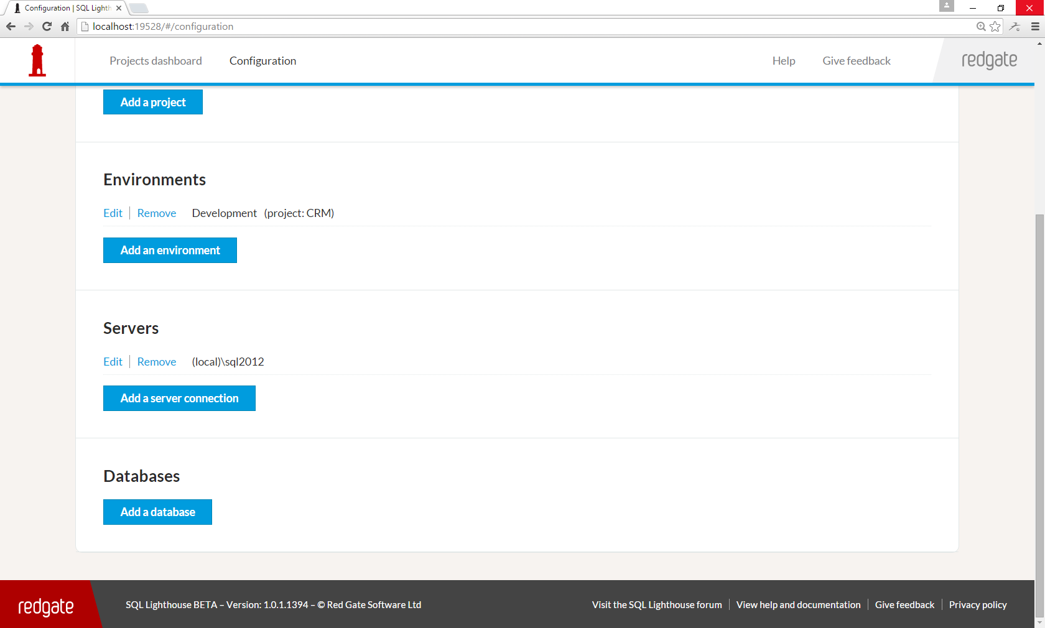
Notes:
Now we can add the database that we want to monitor the schema of.

Slide 52
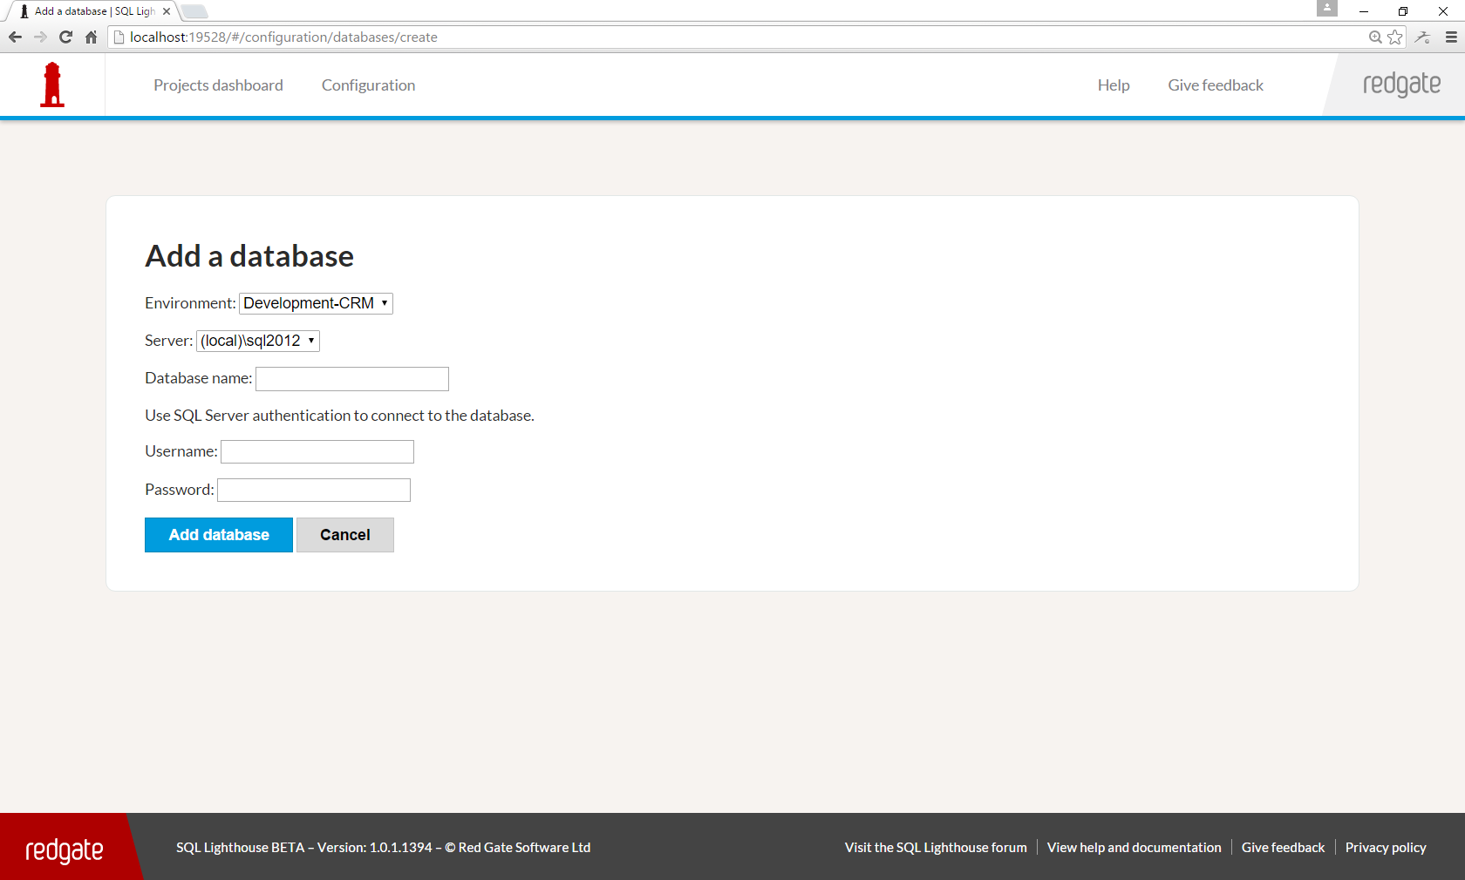
Notes:
And typing in the database name was tricky for some. We saw support issues where people had made typos, and because of our lack of validation, the experience sucked.

Slide 53
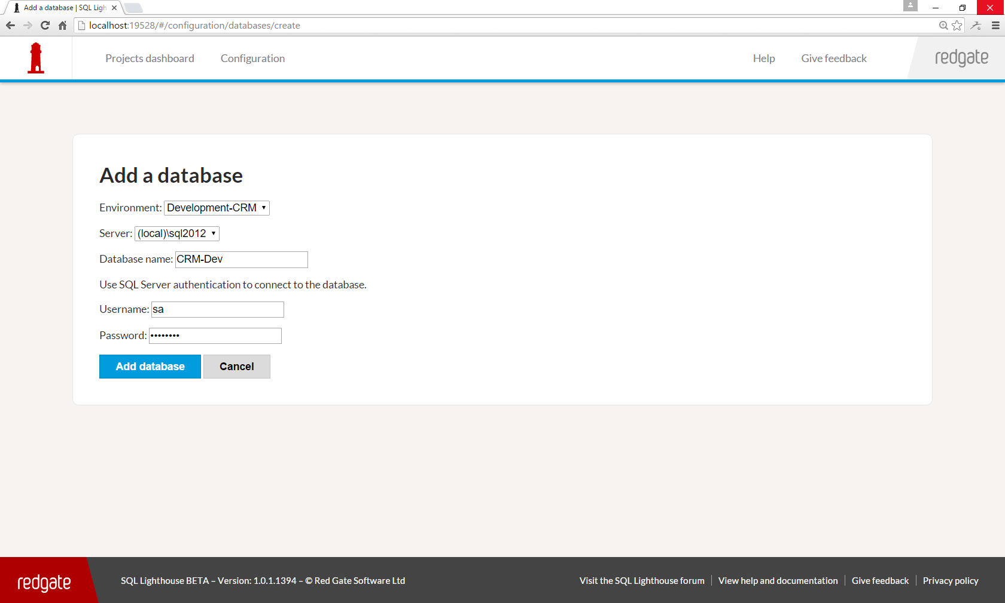

Slide 54
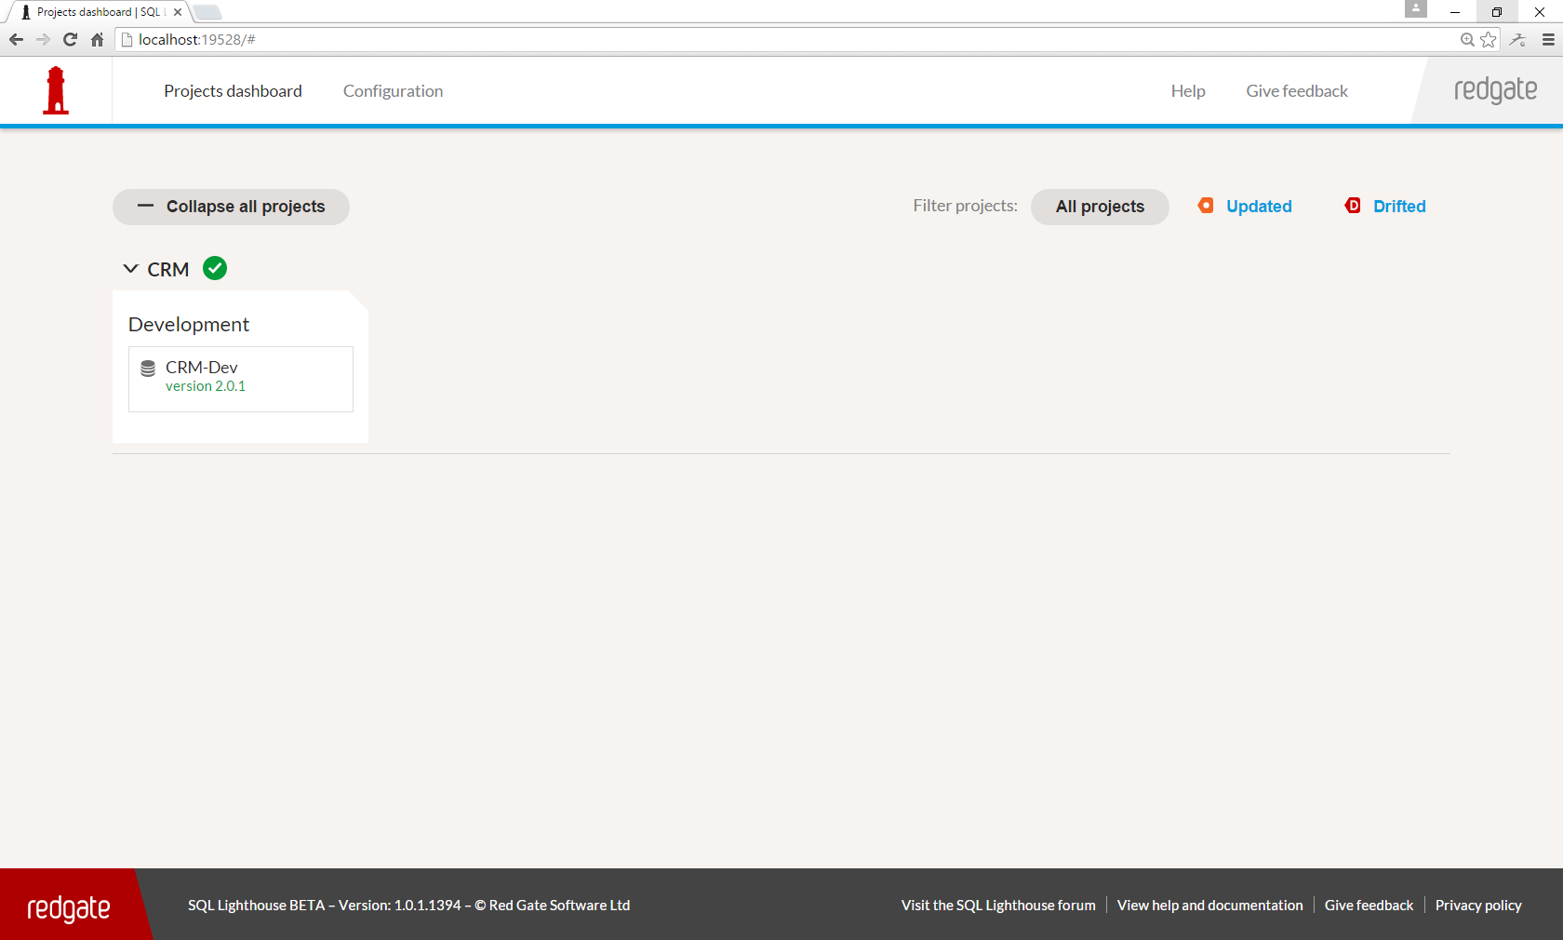
Notes:
And after all that. There’s your reward. Database number 1 on the dashboard. Imagine going through all those pages again to add a second database!

Slide 55
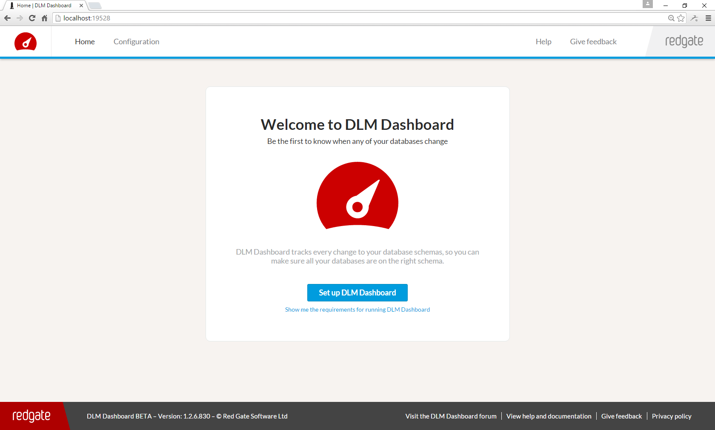
Notes:
So, here’s the changes we made… Firstly, we renamed the product, instead of being called “SQL Lighthouse”, instead, we called it “DLM Dashboard”.
Our hope was that this rename would help make the value proposition a bit clearer and better explain how this product was related to other Redgate products – that the product is designed to monitor the whole pipeline of the DLM process.

Slide 56
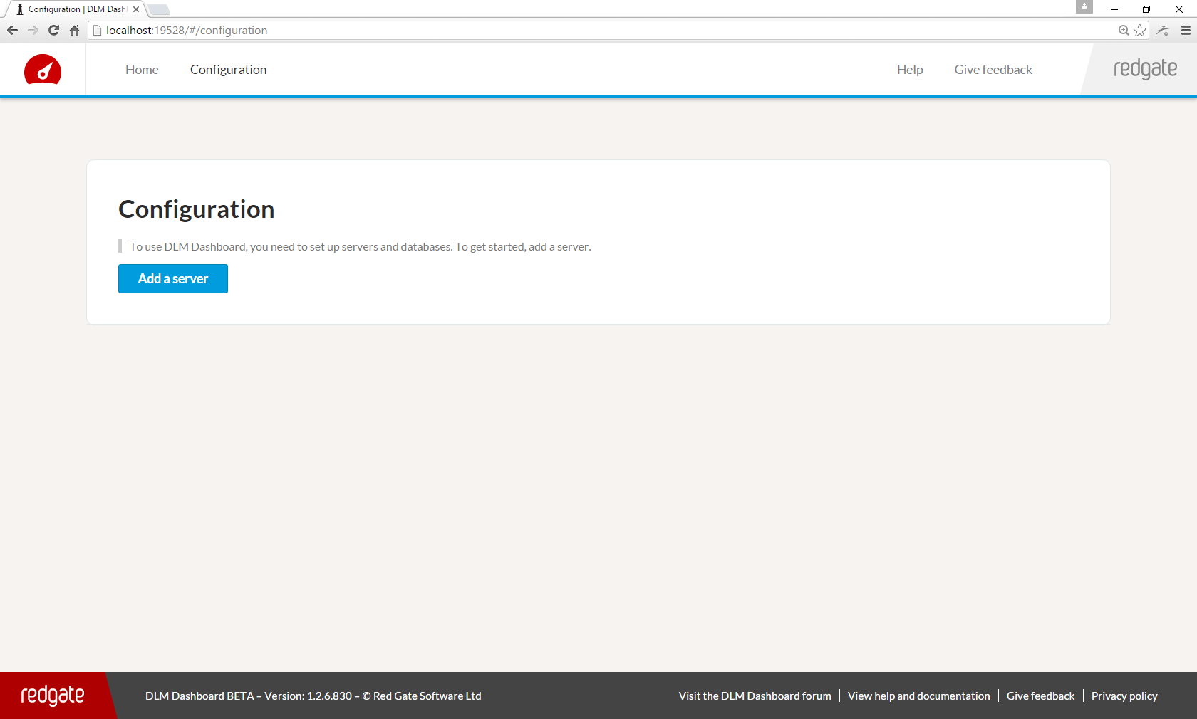
Notes:
Next up, we removed projects and environments completely.
So the configuration page starts with adding a server, just like people expected.
Projects and environments just didn’t gel with how some users wanted to configure the product, so they had to go.
However, we added them for a reason – they made showing the pipeline of dev, test, staging, and production possible. So removing them, obviously means that we couldn’t do that anymore. As we’ll see in a few minutes, we found a much nicer way of adding them back in. A way that our users could actually understand and use.

Slide 57
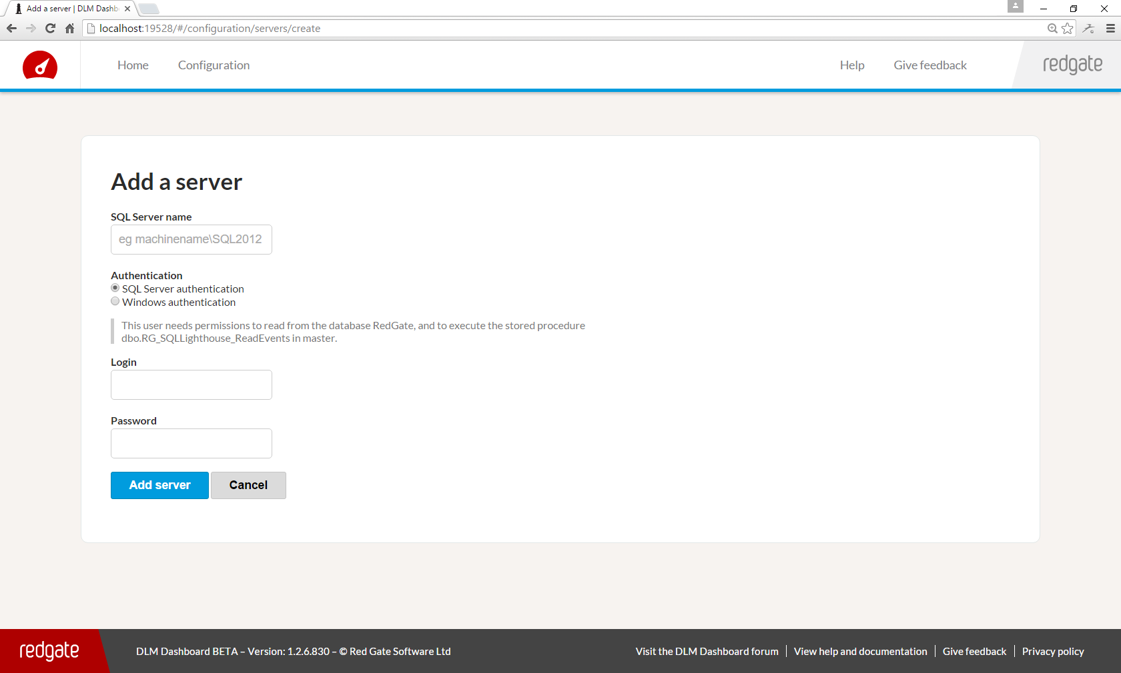
Notes:
We got rid of display name, because it was confusing, now we just show its address everywhere instead.

Slide 58
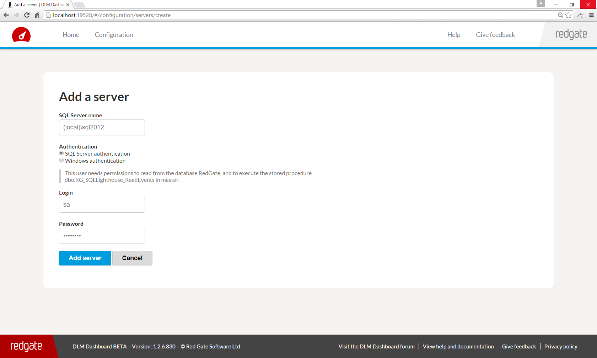

Slide 59
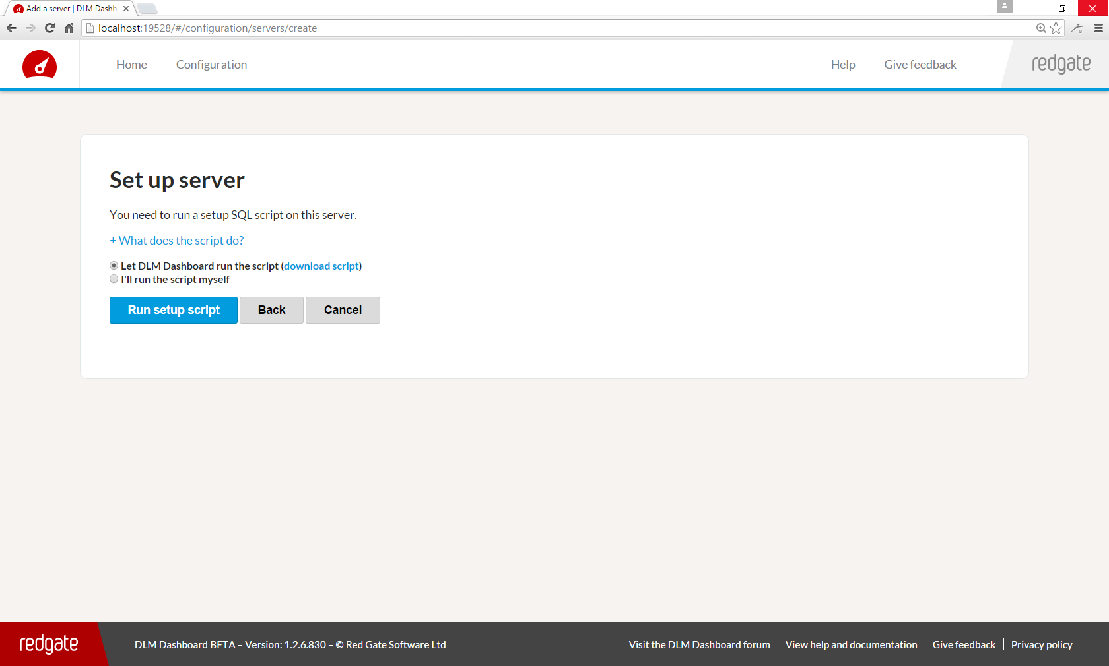
Notes:
Rather than having the user download and run the SQL to install the DDL Trigger themselves, we do it within the tool. This reduced people dropping out at this stage.

Slide 60
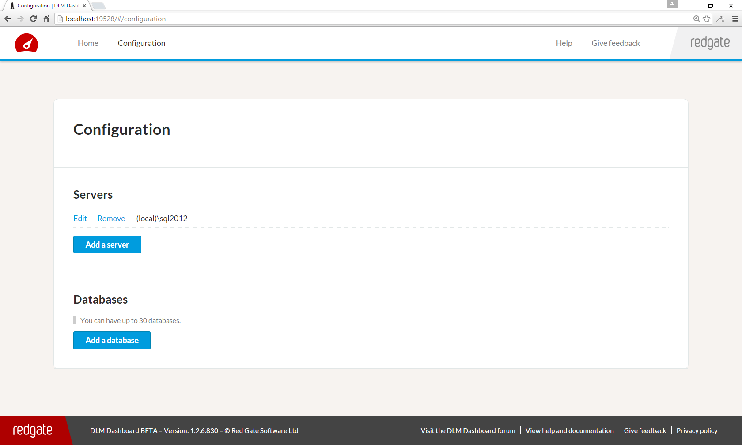

Slide 61
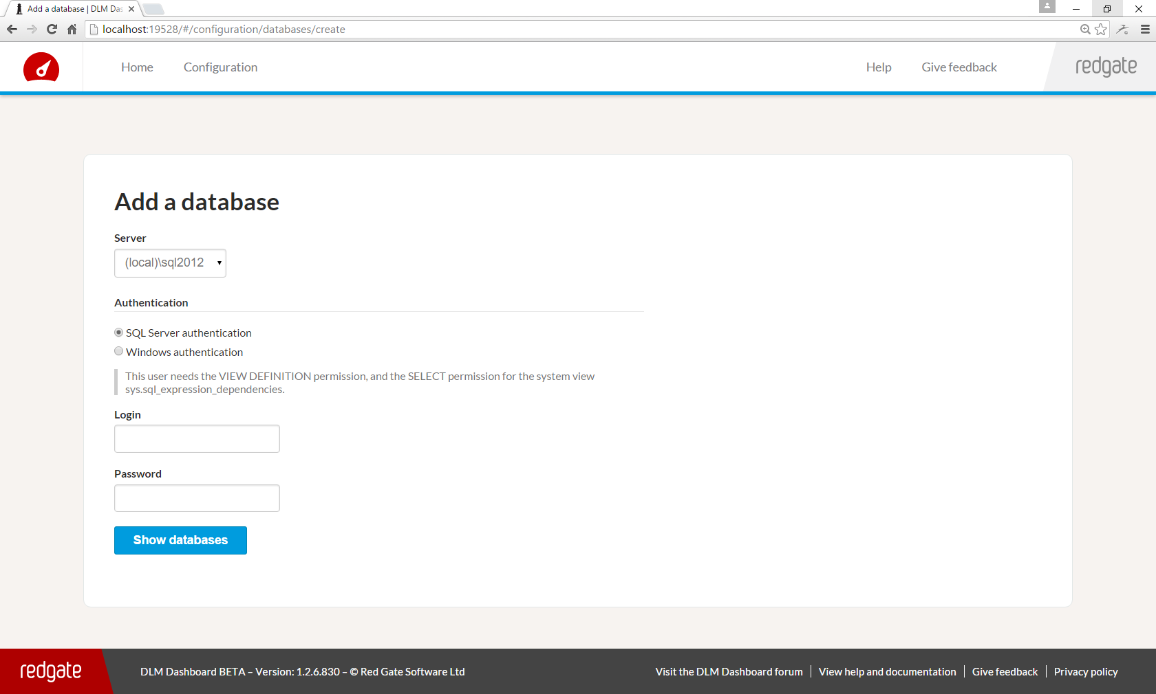

Slide 62
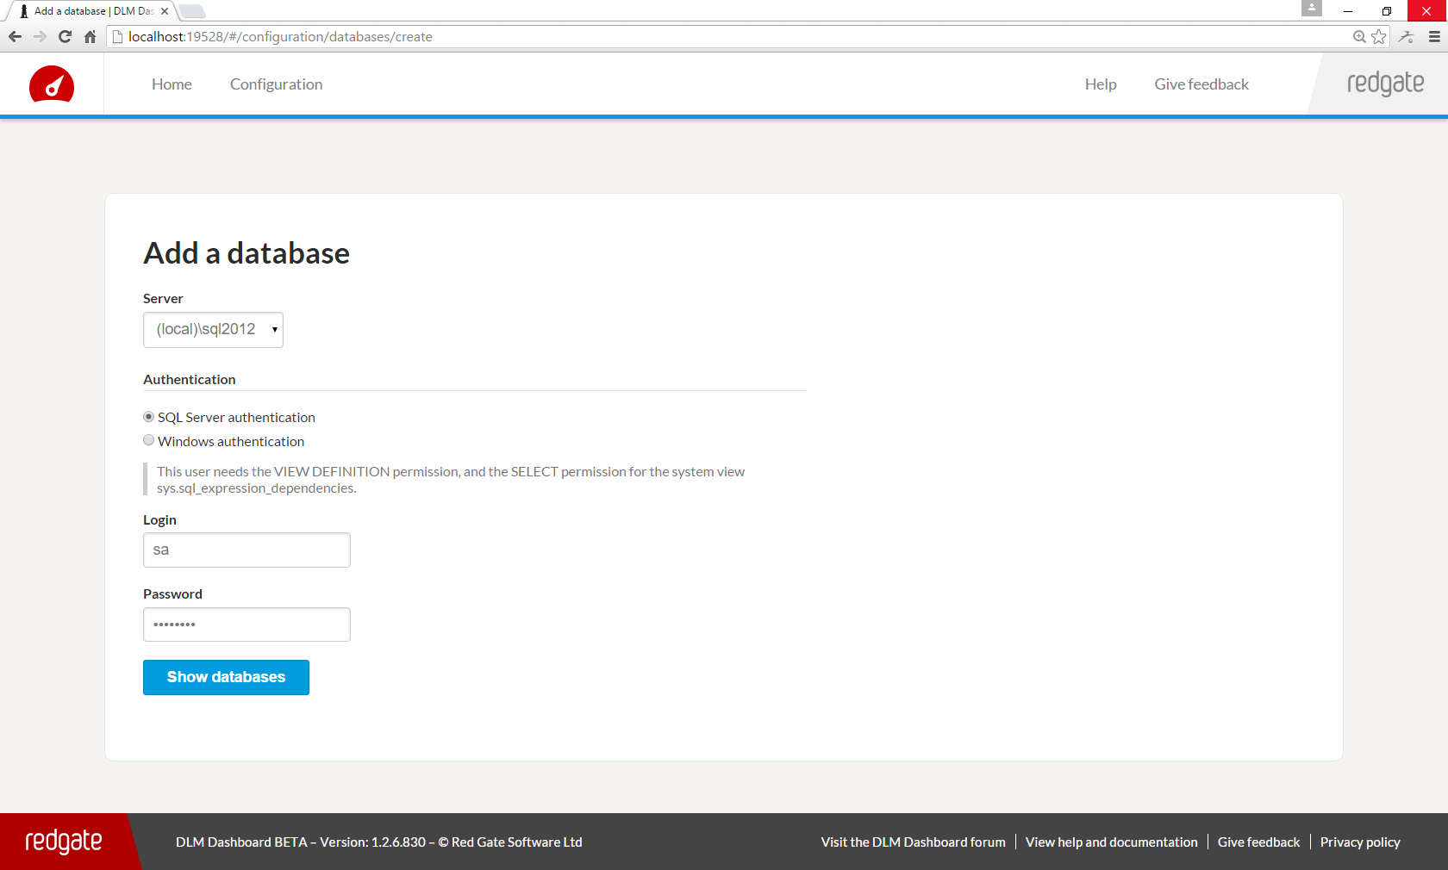

Slide 63
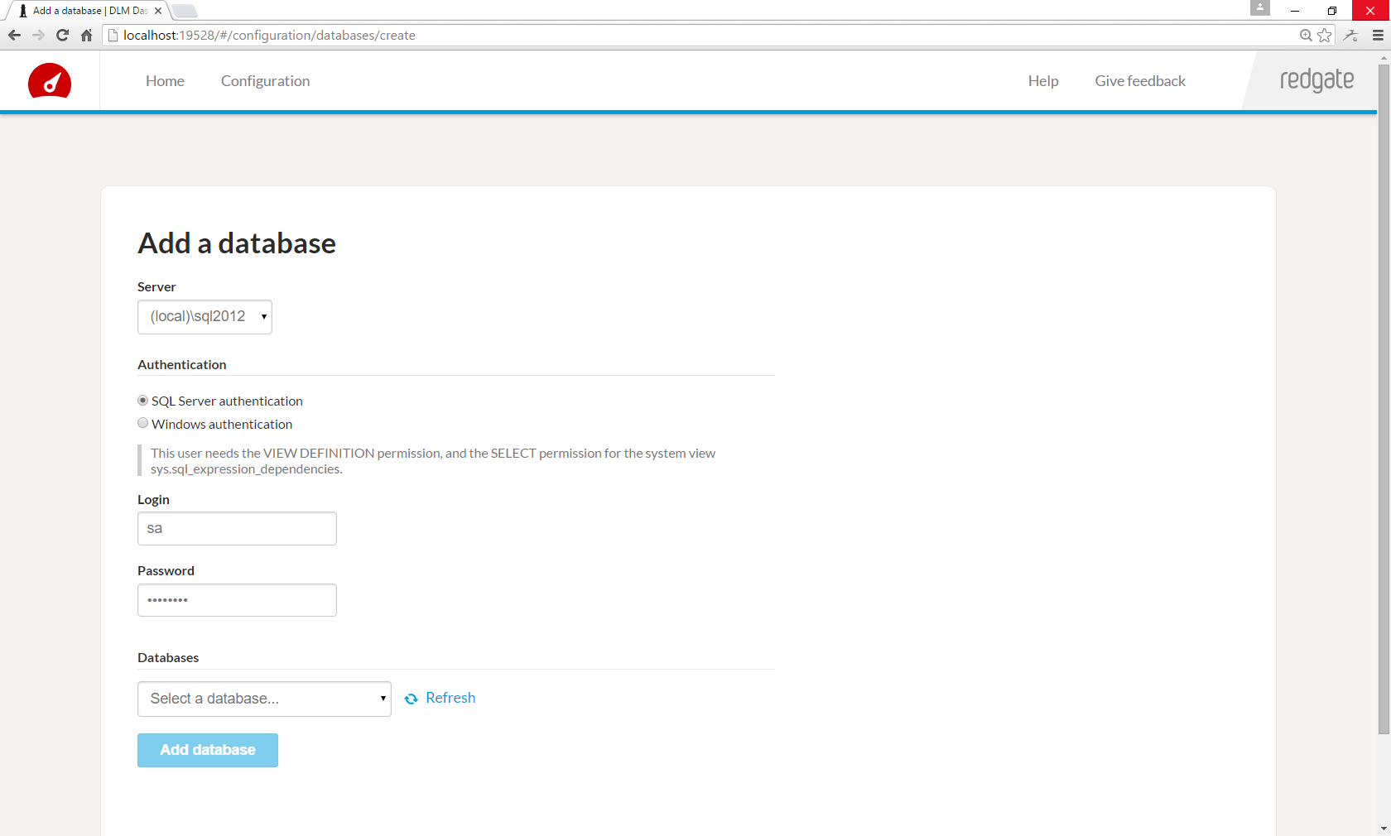
Notes:
And we added a drop-down of the databases on the server.

Slide 64
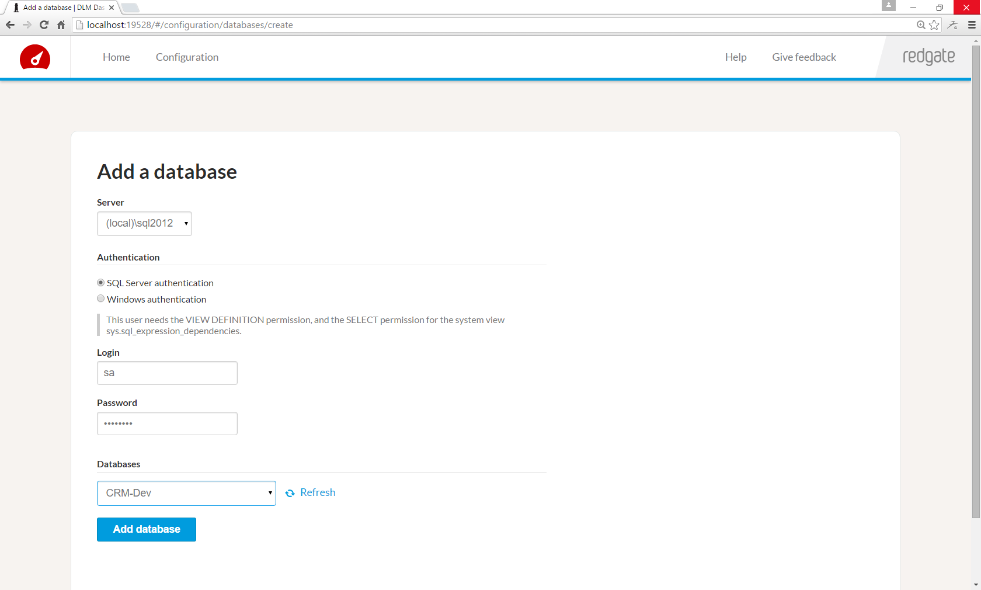
Notes:
Because by choosing from this drop-down, it eliminated typos.

Slide 65
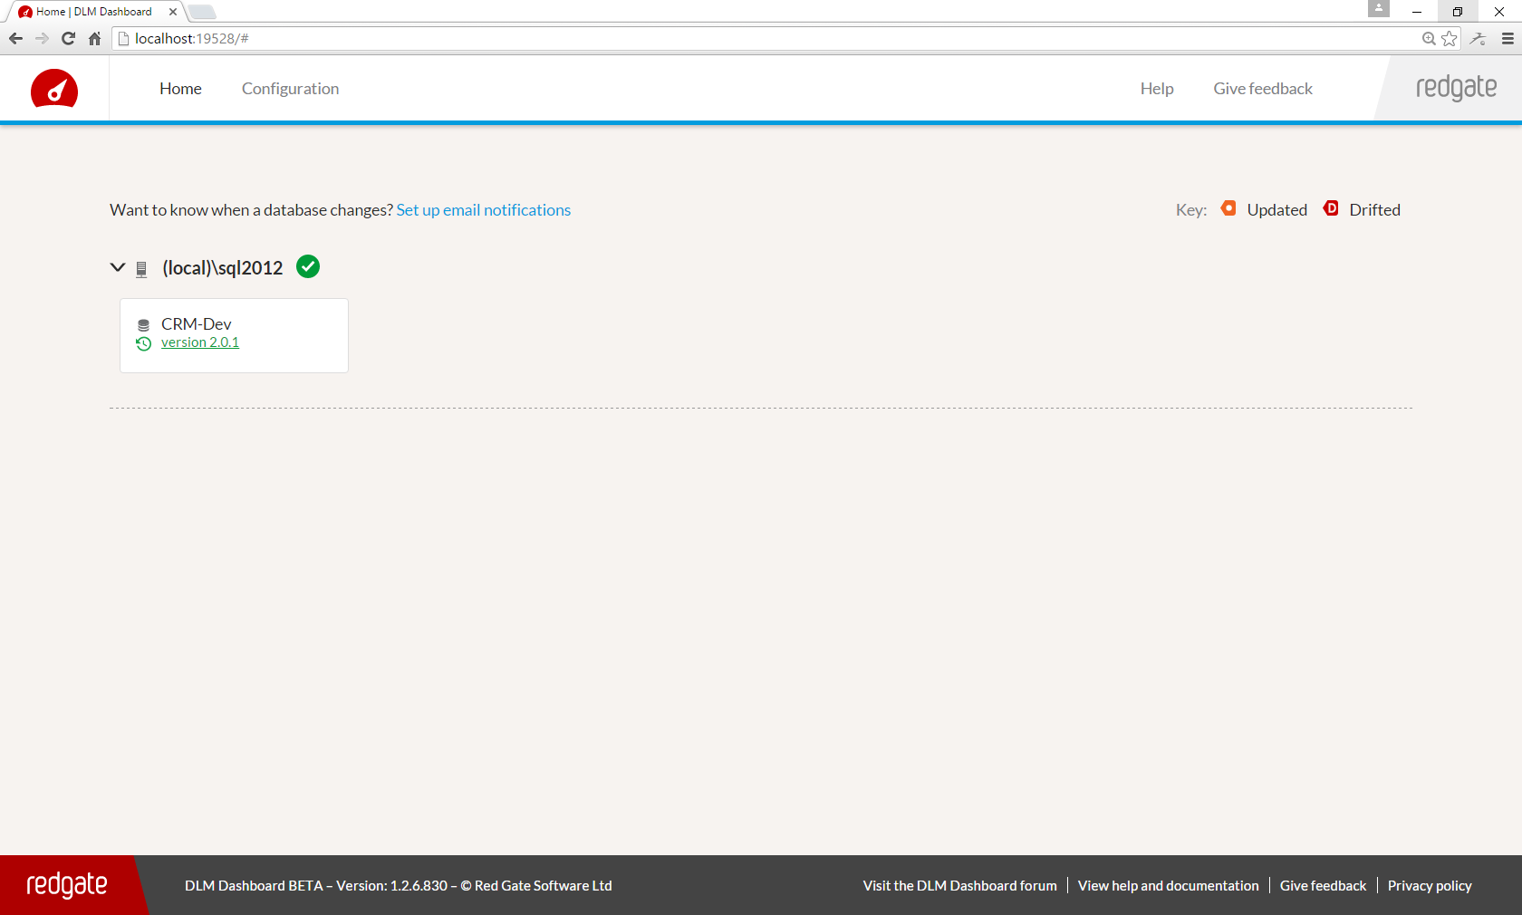
Notes:
And so it got much simpler to add a database. We saw increased conversion, fewer support requests, good stuff!

Slide 66
UI changes
Added configuration
Improved styling
Funnel optimisations
Added back project & environment concepts
Notes:
Now let’s talk about how we added back projects and environments, but in a way that our users could understand and use.

Slide 67
Notes:
So this is the screenshot of what it looked like after we removed projects and environments.

Slide 68
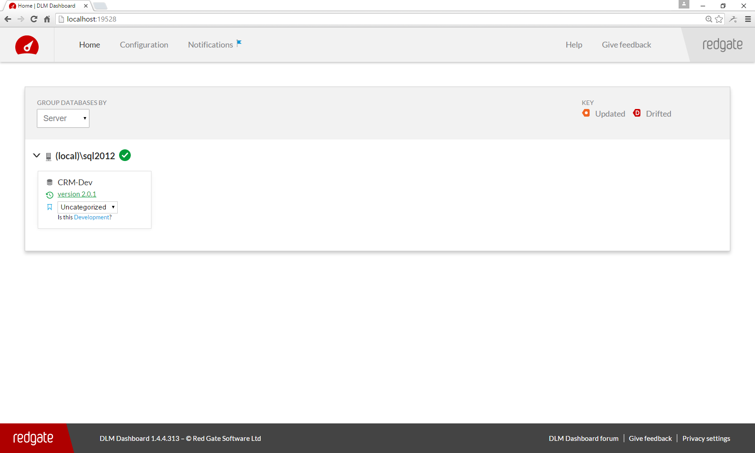
Notes:
And here it is with environments added back in.
Let’s zoom in a bit.

Slide 69

Notes:
Rather than having environments as part of the configuration process, we added the ability to configure them inline after the configuration was complete.
We also provided a set of built-in environments, like Development, Testing, Staging, Production, etc… and the reason why was to make the process simpler, because they user could choose the environment from a drop-down, rather than having to type a name in.
And finally, we added that “Is this Development?” link. We used machine learning to guess what environment the database is in, using its name, characteristics of the SQL Server such as its uptime, amount of RAM, etc… We chose to use machine learning to make it feel less like setup – if you remember, we took environments out because they put too much of a burden on our users during setup – too much of a burden that some users dropped out of the funnel there – our hope was that it would get it right enough of the time that the user wouldn’t feel like they were doing any setup, and that would make things feel easier.
You can either click the name, or if the machine learning got it wrong, you can also select the environment from the drop-down.

Slide 70

Notes:
Once you’ve chosen, the environment is shown neatly inline like this.

Slide 71
Notes:
Because we were using machine learning, we wanted to get some feedback about how it was performing to see if we needed to tweak the algorithm or rip it out entirely. We used Google Analytics as our collection mechanism and this was the results.
As you can see, it’s good but it’s not great – it’s only getting it right about 60% of the time, but we thought using machine learning was kinda cute, and at least it’s doing better than 50% so we left the machine learning feature in the product ☺

Slide 72

Notes:
And this is how we added projects back in, only this time round we called them pipelines.
We did this by adding a new view and we also switched all of our users to that view. They could still get back to the old view in that ”Group Databases By” drop-down.
We used machine learning to automatically group together databases that had a similar schema into the same pipeline.
We added an in-product survey to collect feedback on how that machine learning did.
It stayed on the screen nagging the user to fill it in, until the clicked either “Yes”, “Almost” or “No”.
If the user clicked “Almost” or “No” then we took them to a full SurveyMonkey survey and asked them how we could improve, and if we could follow up with them about making it better.

Slide 73
Notes:
These are the results of how many people clicked “Yes”, “Almost”, and “No”.
And they had to click one of them, because the question didn’t go away until they did.
We did really well, about 60% said “Yes”, and about 20% said “Almost”, and finally about 20% said “No”.

Slide 74

Notes:
Of the people who were taken to the survey, very few actually filled it in, which is a shame, but it gave us a lesson on the best way to collect feedback.
In-product surveys, like the “Yes”, “Almost”, and “No”, which are really easy to respond to, people did, but surveys outside the app, they were way less likely to fill those in.
So in the future, we put all of our surveys in the app itself. They were designed to feel seamless and were just 1 question, and we got really really good response rates.

Slide 75
UI changes
Added configuration
Improved styling
Funnel optimisations
Added back project & environment concepts
Added manual pipelining
Notes:
The main bit of feedback in those survey responses was around the need to override the machine learning when it got it wrong, so, that’s what we built.

Slide 76

Notes:
Here’s what it looked like before we added the manual override.

Slide 77

Notes:
And here’s after. There’s this small icon here, and when you click it, you get…

Slide 78

Notes:
A dropdown, where you can move a database to a different pipeline or create a new one.
So, in conclusion, now let’s think about the 2 groups of users we’ve designed this for:
The first group, who want the whole pipeline thing, it’s much easier for them than with projects – with all the machine learning they’ll have this set up faster than they would have managed to do when they were entering all the projects and environments details in the configuration process
The second group, who don’t want the whole pipeline thing, it’s much easier for them now too. They can either just have 1 database on a pipeline, or they can use the drop-down to move to a view more suited for their needs. The configuration process isn’t bloated asking them questions about projects and environments that they don’t care about.

Slide 79

Notes:
In the last section of this talk I’m going to talk about scope.
The reason why aggressively controlling scope matters, is that if you’re not careful, you’ll build things that the users don’t need and don’t want.
That, is time wasted.
It’s time that could be better spent elsewhere.
Also, if a story is delayed from shipping because of gold plating and having bells and whistles attached, then because adding those things has delayed it from shipping, that’s delayed it getting into the hands of users, and it’s delayed the feedback from the users.
Perhaps the users don’t want a bell or a whistle, or perhaps, they do, but another story on the backlog is more important to them.
These are all the reasons why we aggressively managed scope.

Slide 80
Email
Plain text email
HTML email
Test button
Configuring when it was sent
Better explaining of errors
Notes:
Here’s a concrete example of how we managed the scope.
http://uiwriting.tumblr.com/post/127166150889/improving-other-peoples-error-messages

Slide 81
Techniques we used
Story breakdown meeting
Notes:
Get everyone on the same page at the beginning of the story (avoids confusion & re-work)
What’s in scope
What’s not
What will the UI look like
What are we going to store in the database

Slide 82
Techniques we used
Story breakdown meeting
Splitting stories
Notes:
Split the stories, like we saw for email, closely related to what’s not in scope

Slide 83
Techniques we used
Story breakdown meeting
Splitting stories
MoSCoW
Notes:
When we broke down the story we MoSCoW’d the post-its, and we even did MoSCoW for bugs that we found during the story too
Sometimes, e.g. with protecting users’ passwords, you have to just gold plate it, because that’s the Must

Slide 84
Techniques we used
Story breakdown meeting
Splitting stories
MoSCoW
Release train

Slide 85

Notes:
Release train
https://twitter.com/cj_smithy/status/522693367424352256
https://twitter.com/cj_smithy/status/527512516688375810
http://leadingagileteams.com/2015/02/01/applying-the-agile-release-train-to-a-single-team/
http://leadingagileteams.com/2015/02/09/5-benefits-of-the-agile-release-train-for-a-single-team/

Slide 86
Techniques we used
Story breakdown meeting
Splitting stories
MoSCoW
Release train
Woodland creatures

Slide 87



Notes:
We move items between Must, Should and Could throughout the story as new feedback comes to light, and we also use the size of the story to influence that too.
http://workingwithdevs.com/woodland-creatures/

Slide 88
Techniques we used
Story breakdown meeting
Splitting stories
MoSCoW
Release train
Woodland creatures
On-demand configuration through documentation
Notes:
app.config infrastructure, e.g. for email window, which TCP port we listened for connections on, etc…

Slide 89
Techniques we used
Story breakdown meeting
Splitting stories
MoSCoW
Release train
Woodland creatures
On-demand configuration through documentation
Visualising debt

Slide 90


Notes:
Tech debt
UX debt
https://twitter.com/_AlexYates_/status/501685529378058241
http://workingwithdevs.com/technical-debt-singularity/
http://www.touchdeluxe.co.uk/visualising-ux-debt/

Slide 91
Summary

Slide 92

“We did the news well. You know how? We just decided to.”
Notes:
This is a quote from my favourite TV show.
“We did the news well. You know how? We just decided to.”
And I think that quote applies here too.
“We just decided to.”
So, if you want to get better at this kind of stuff, just decide to!
Make a start; hopefully I’ve given you a whole bunch of ideas, but by starting, you’ll learn for yourselves what works for you in your team, and you can iterate from there.
So let’s recap very quickly the different ways we listened:

Slide 93
A summary of how we listened
Conferences, private alpha, public beta
User research and covering a wall in post-its
User journals, UX tests
Auto emails, UserVoice
Surveys (in product, loss analysis, on uninstall)
Support queries, automated error reporting
Usage metrics, funnels
Notes:
We got feedback from a whole variety of sources.
The key thing is to seek it out, listen and not ignore it!

Slide 94
</talk> any questions?

Slide 95
Any questions?
Slides: www.davidsimner.me.uk
Email: david.simner@red-gate.com

